Slide 1
HIGH FREQUENCY MEASUREMENT TECHNIQUE
(SCALAR MEASUREMENT)
Sutrisno,BSEE,MT
Head of Telecommunication Laboratory
Electrical Departement
Telecommunication Engineering

Slide 2
Rules
Marking
Assignments 20%
Mid 40%
Final 40%
Presence may help borderline cases
Time
07.00-9.30 (3A)
09.50-12.20 (3B)
Venue
School Building(R.A210 for 3A)
School Building(R.A210 for 3B)

Slide 3
Please, register and joint our WA groups : HF2016
HP : 081912161945

Slide 4
Course Outline
Microwave scalar Measurements
Scalar Impedance Measurements (Reflectometer)
Swept Slotted Line Measurements
Scalar Transmission Measurements
Z_{o} Power Measurements

Slide 5
Scalar Measurement
Magnitude and Freequency Information only
Most commonly used measurement technique
Microwave devices are usually specified in scalar values (VSWR, return loss, ρ, gain (dB))
Scalar measurement systems are less expensive when compared to system that measure complex parameters (mag & phase)

Slide 6
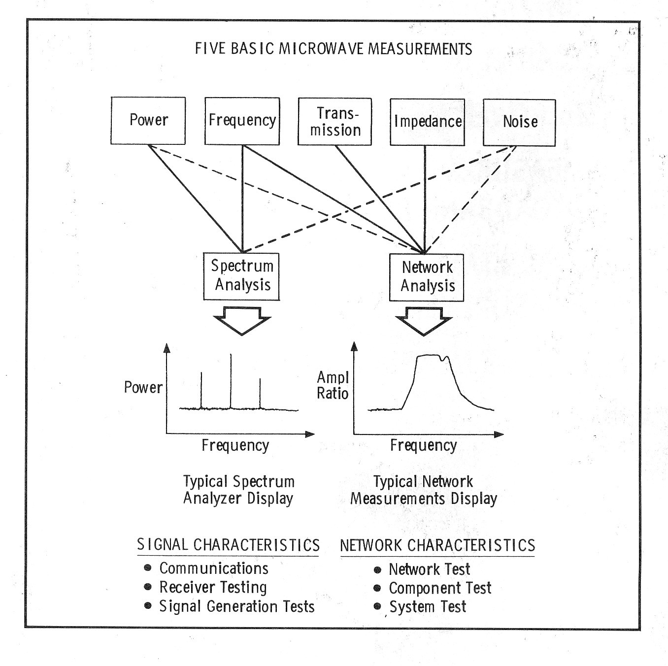

Slide 7
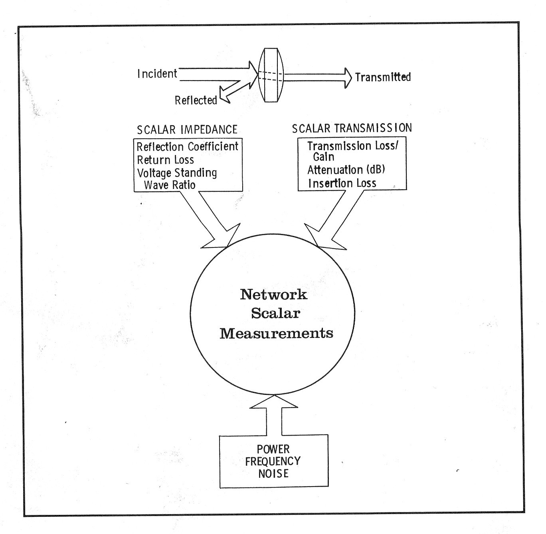

Slide 8
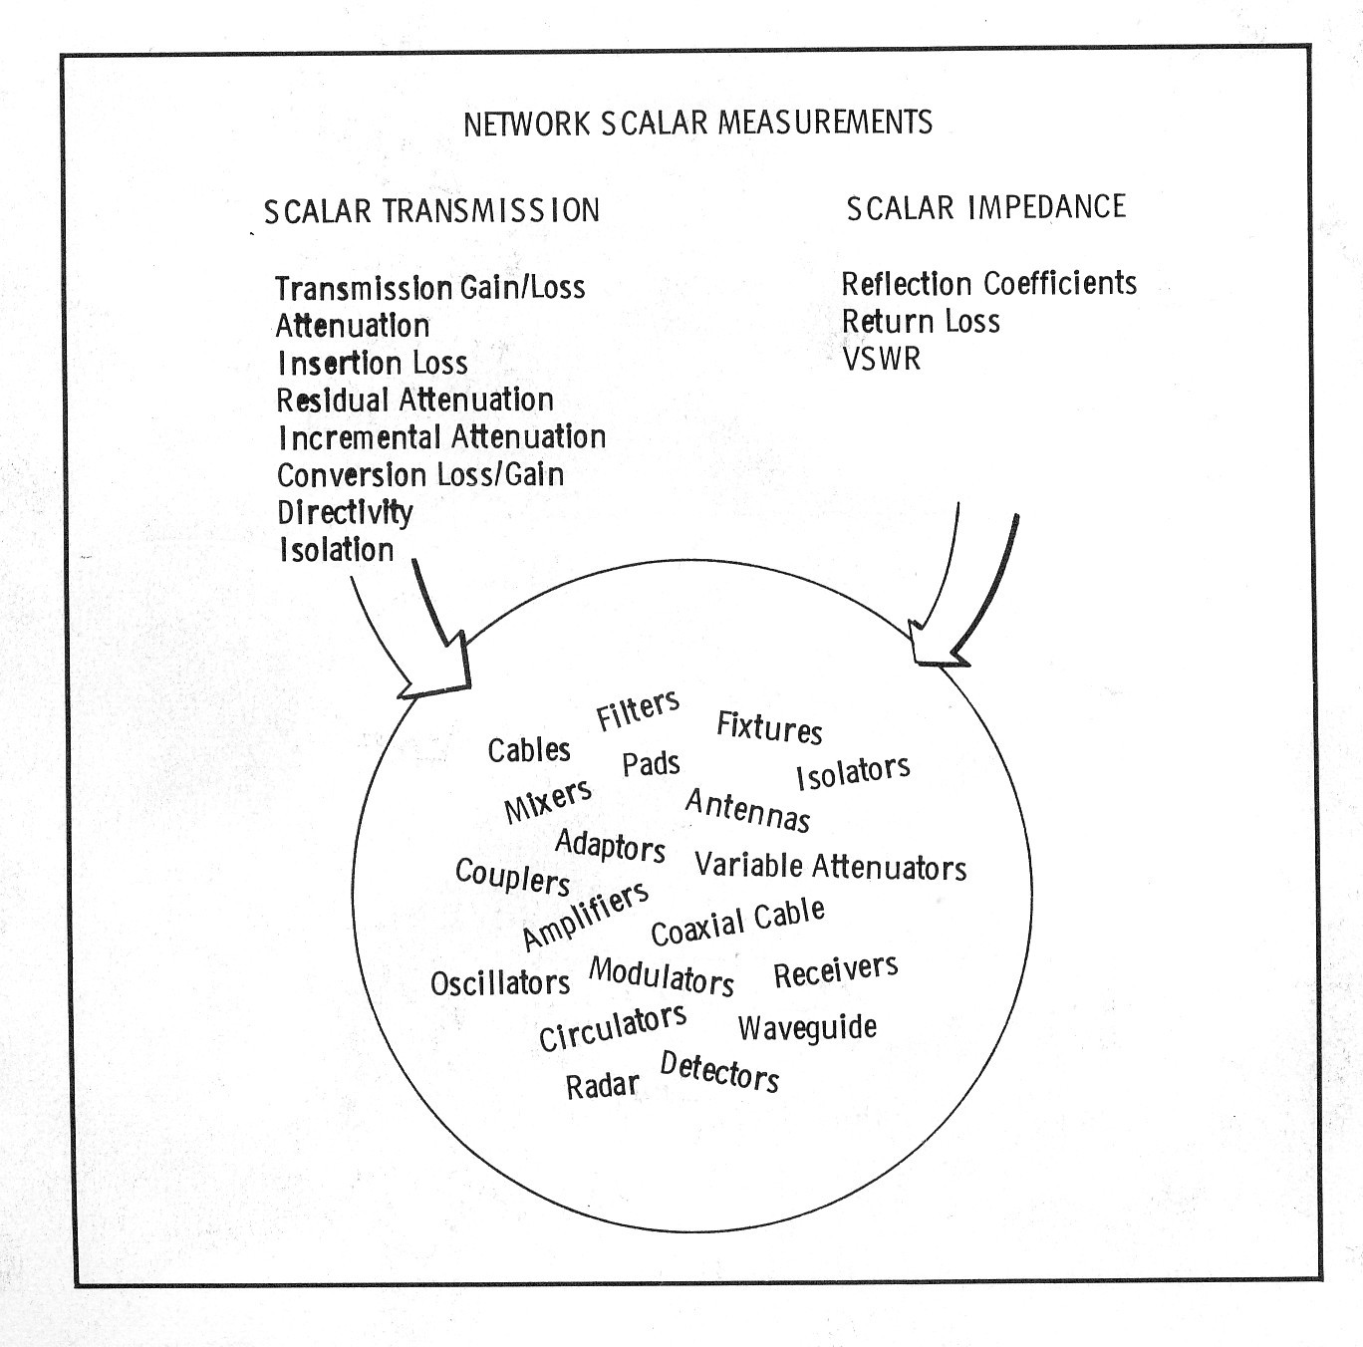

Slide 9
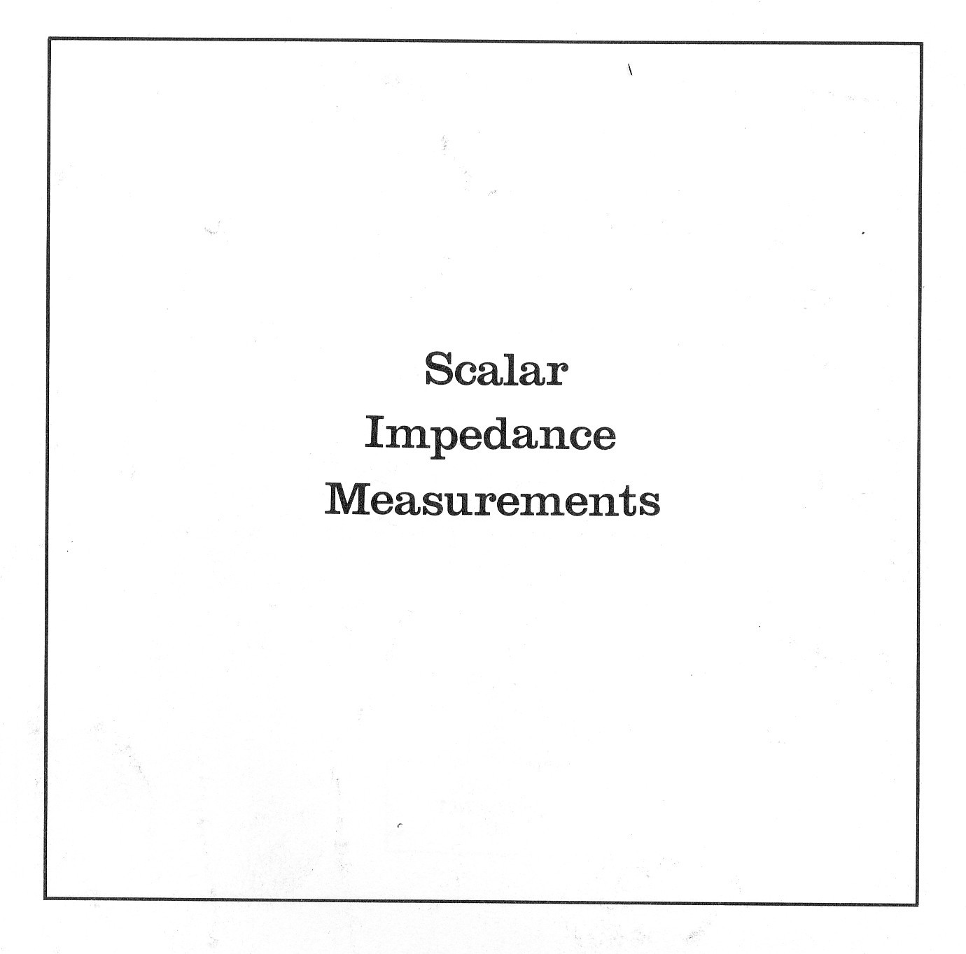

Slide 10
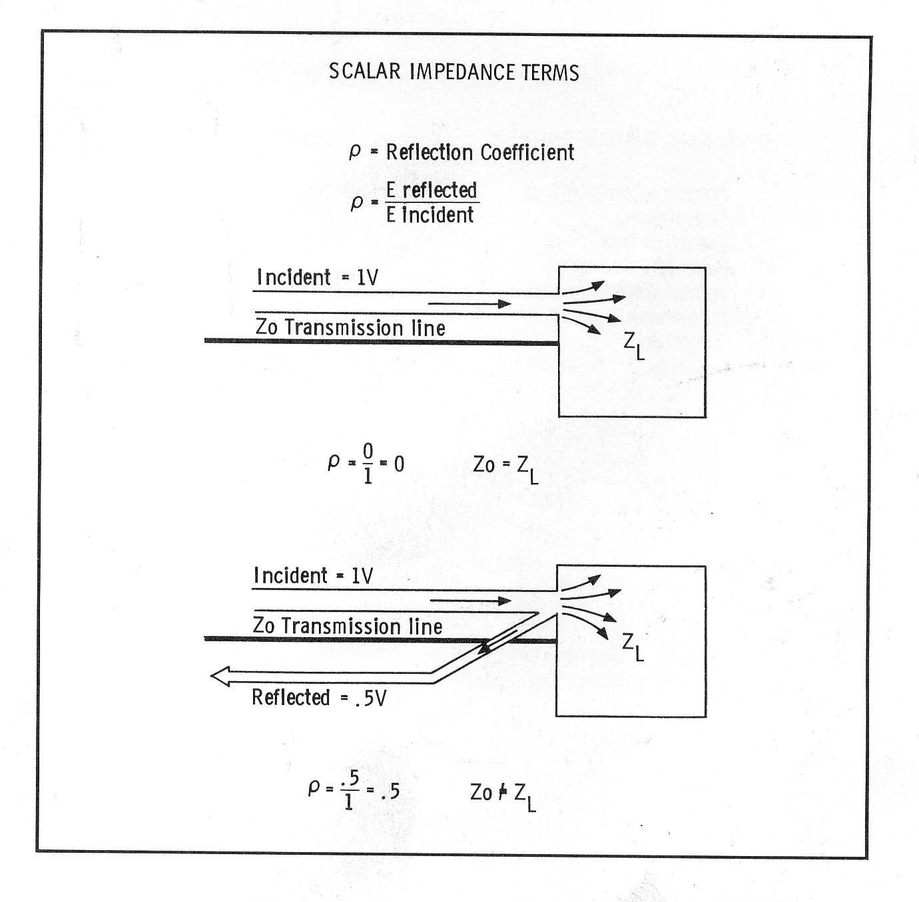

Slide 11
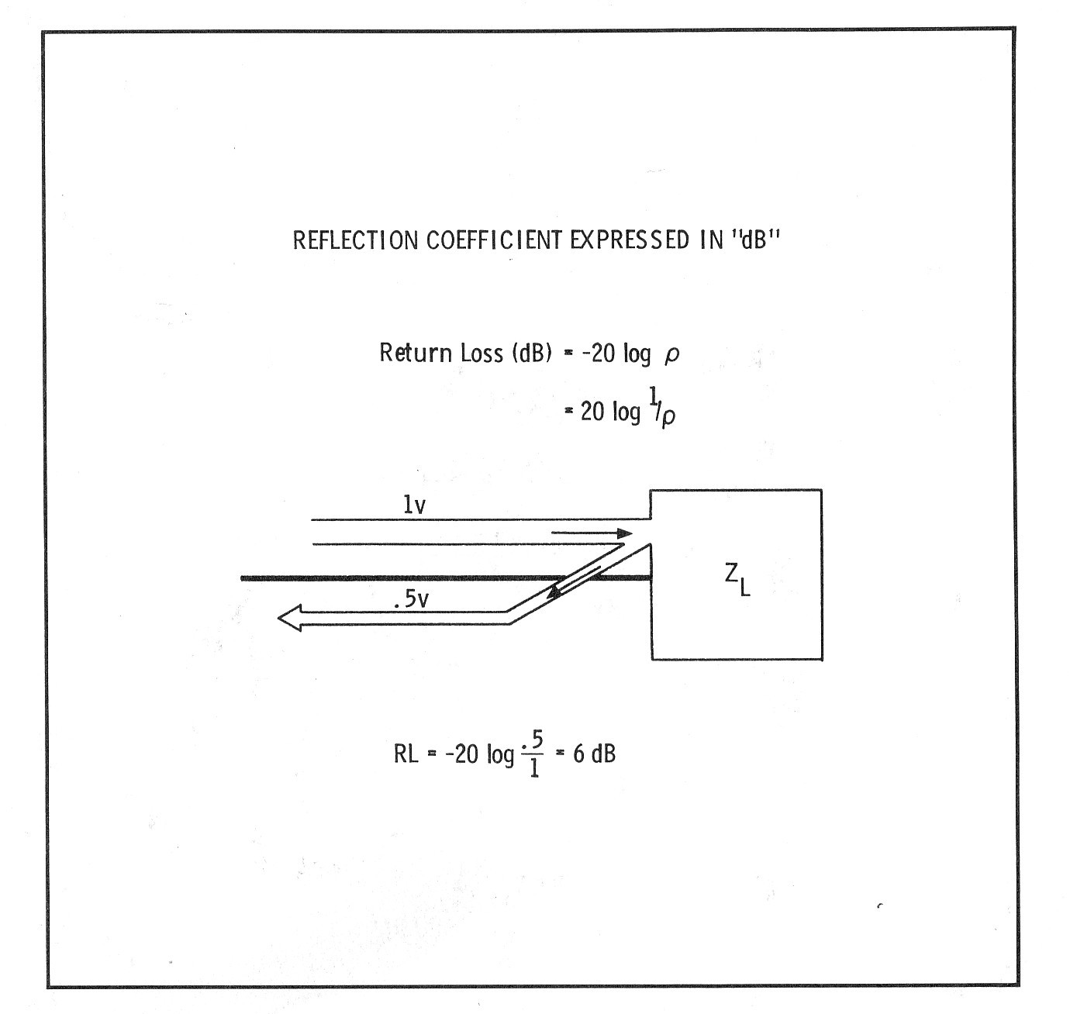

Slide 12
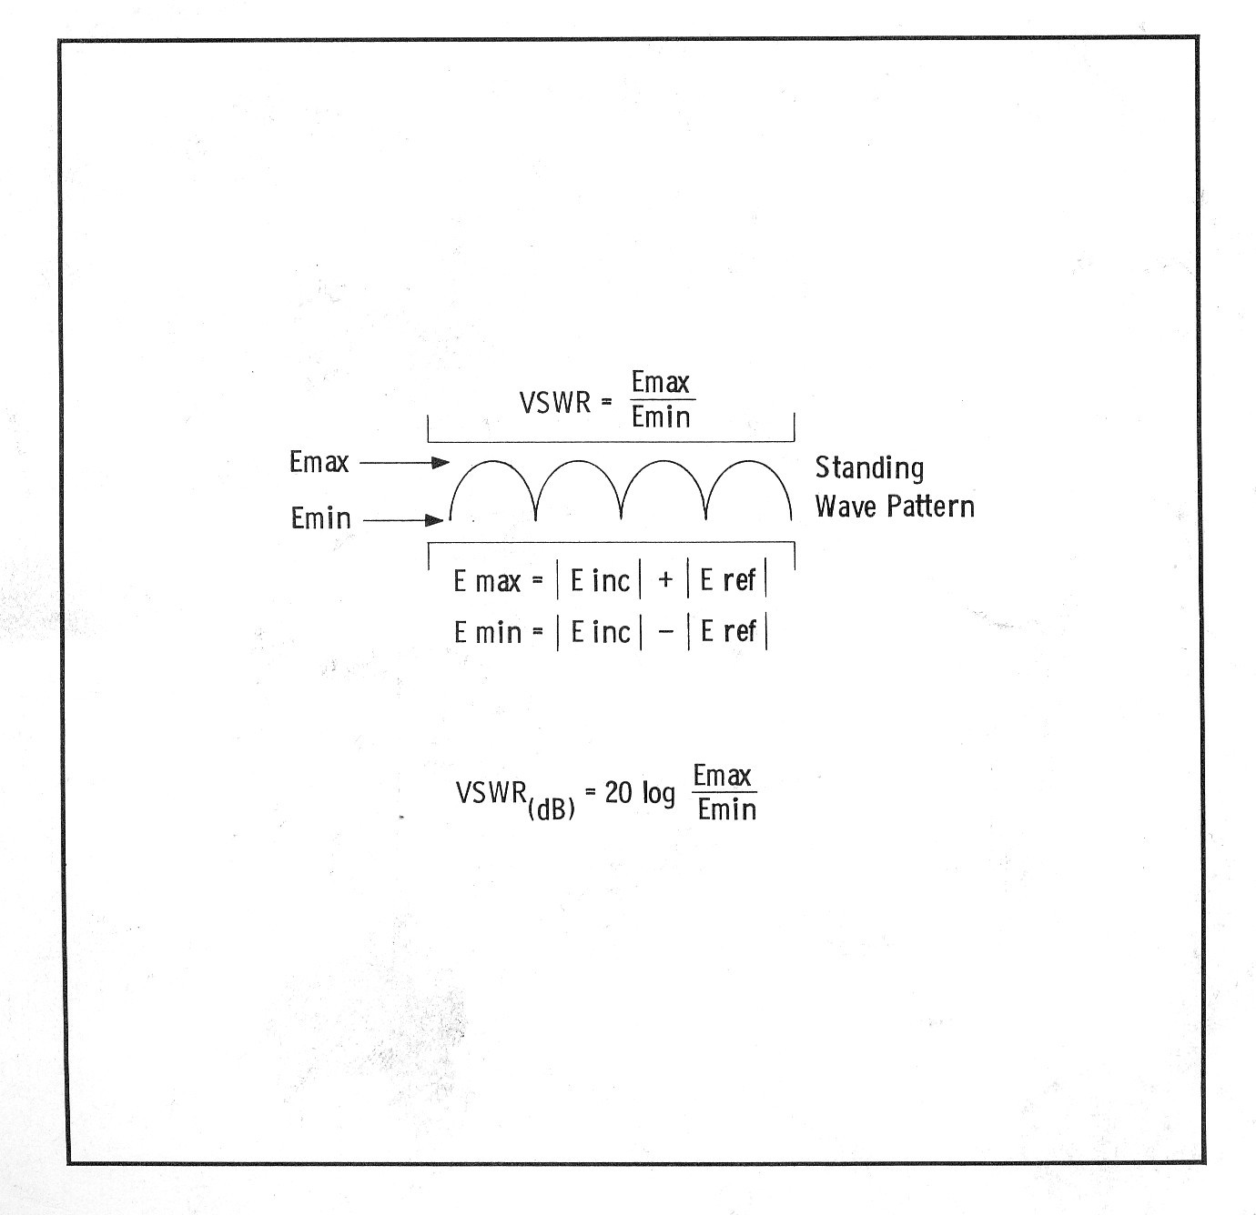

Slide 13
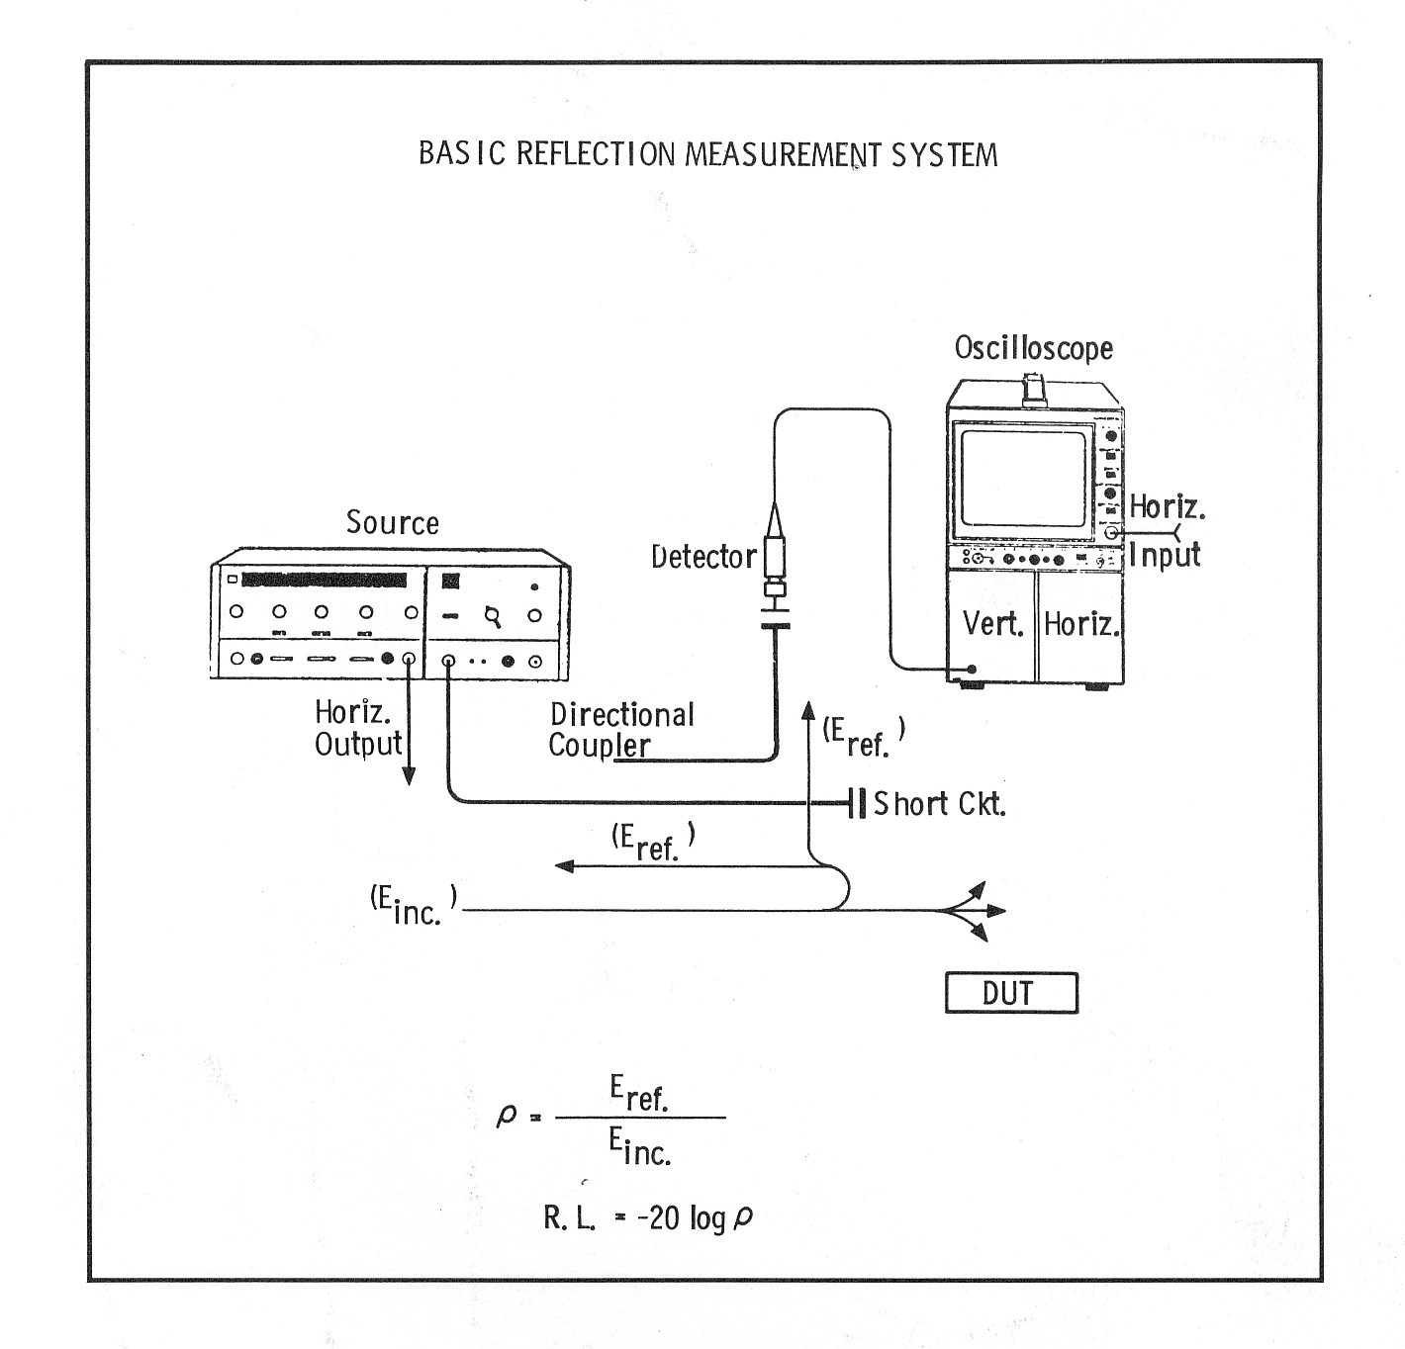

Slide 14
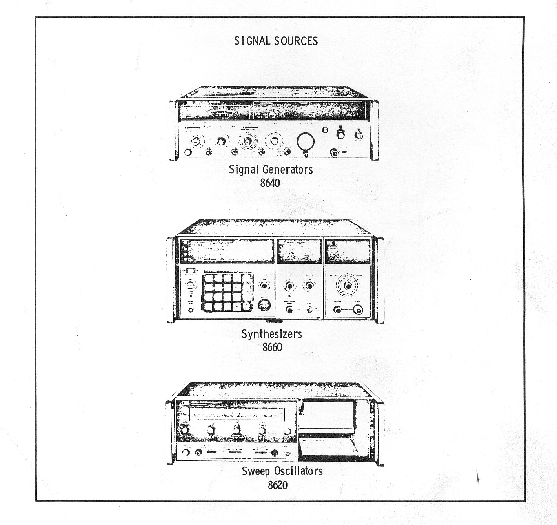

Slide 15
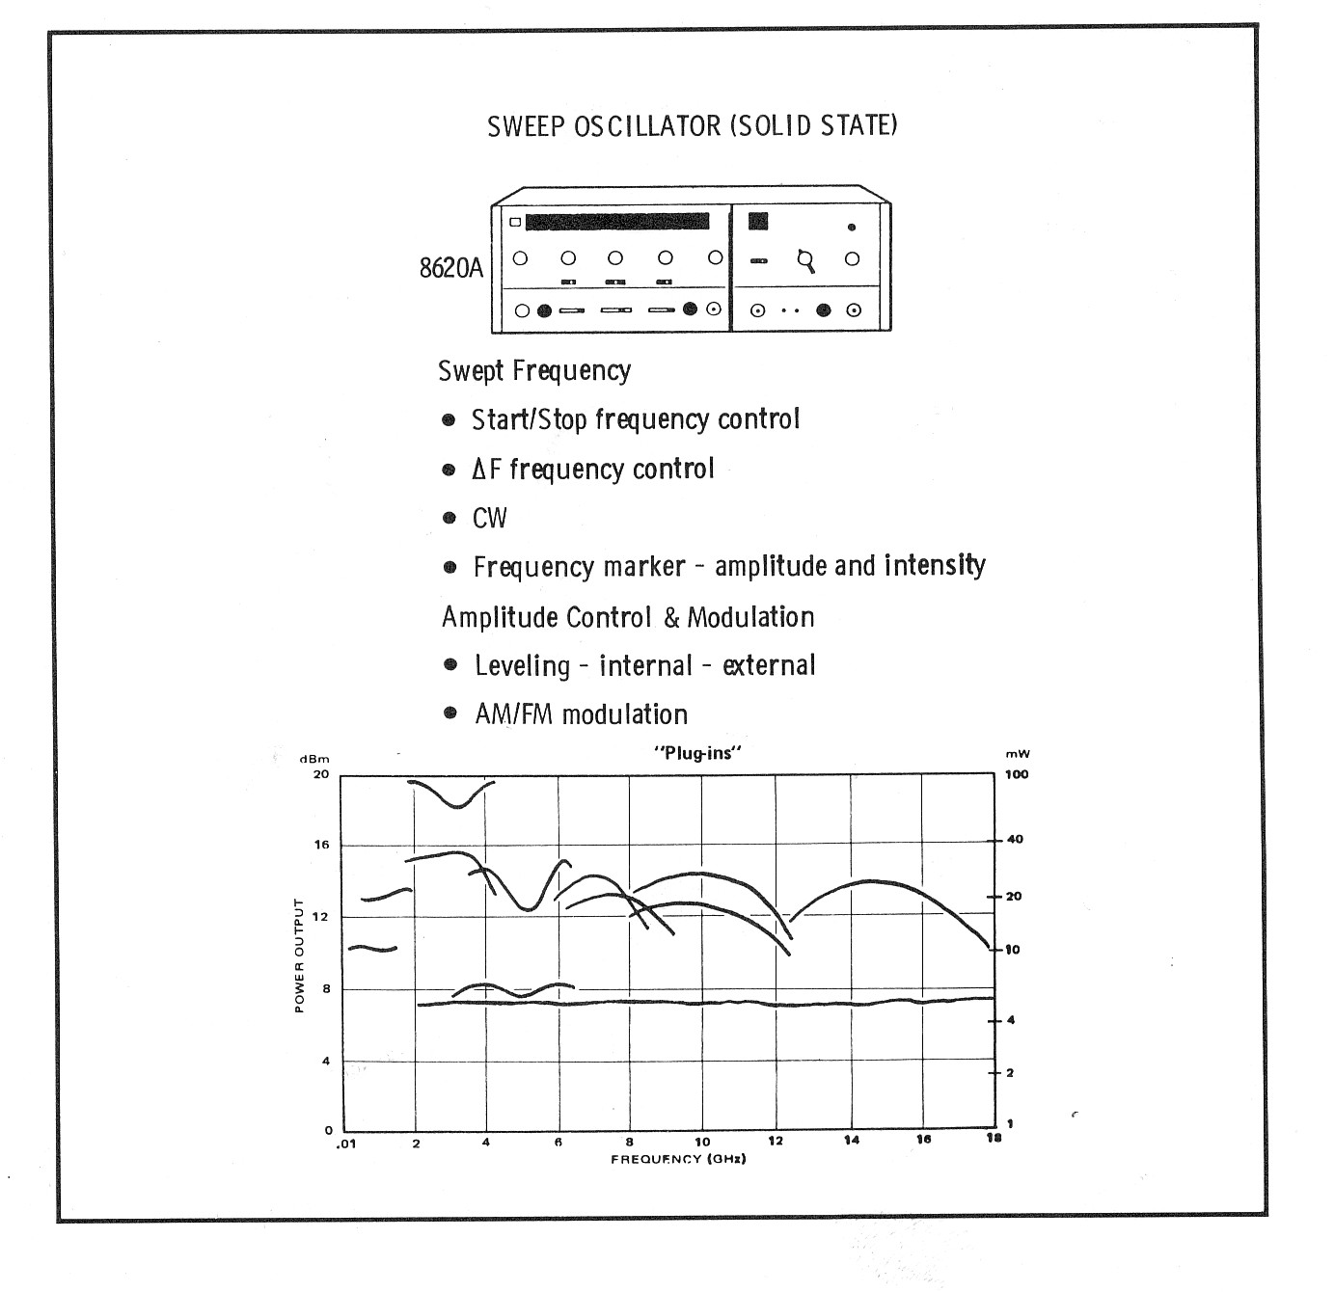

Slide 16
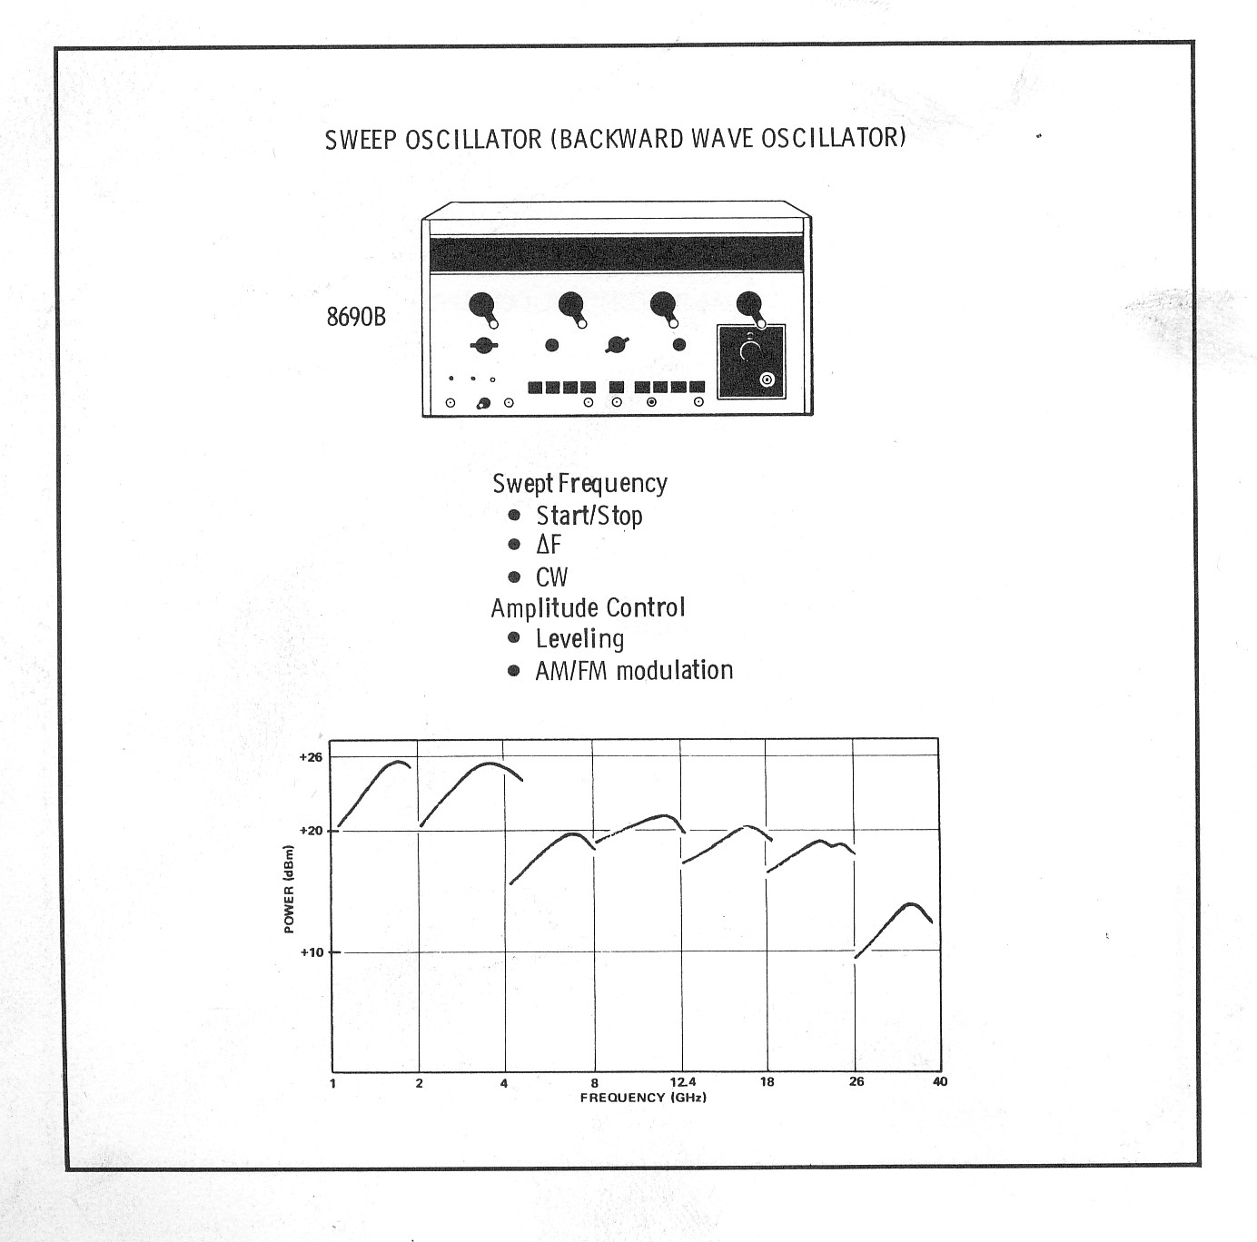

Slide 17
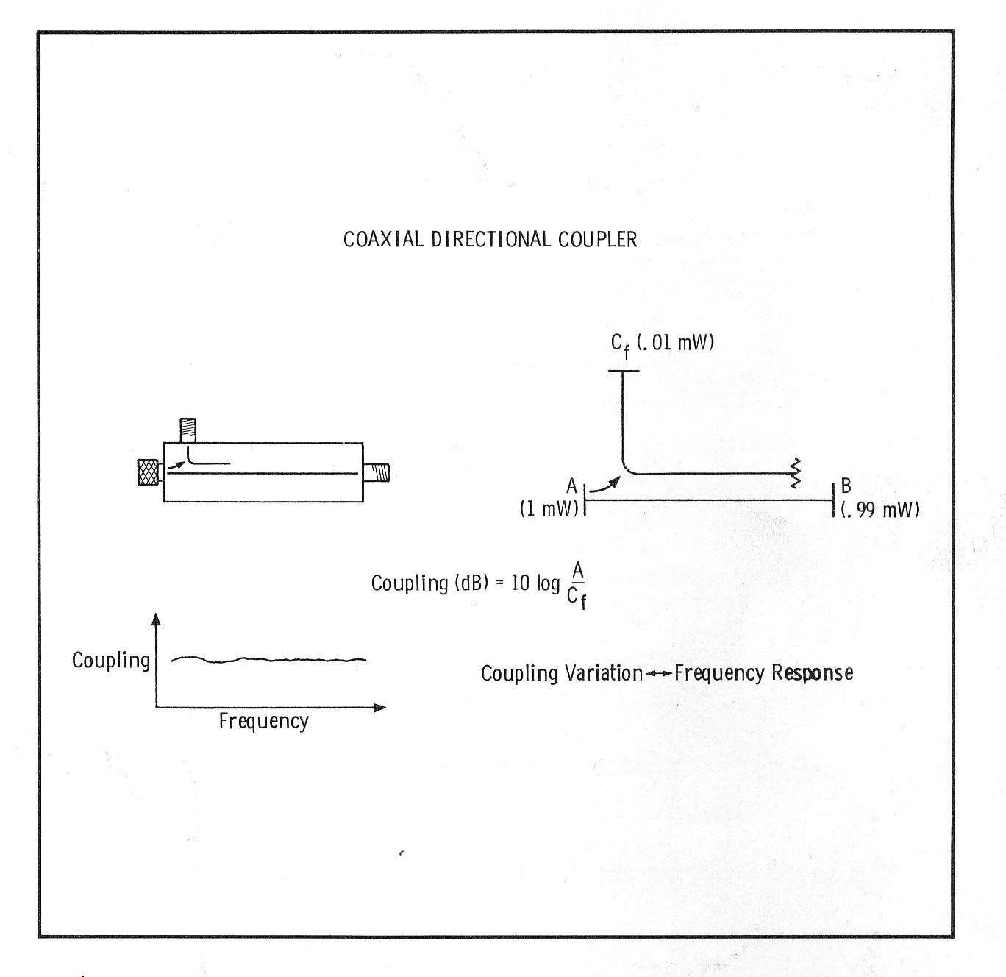

Slide 18
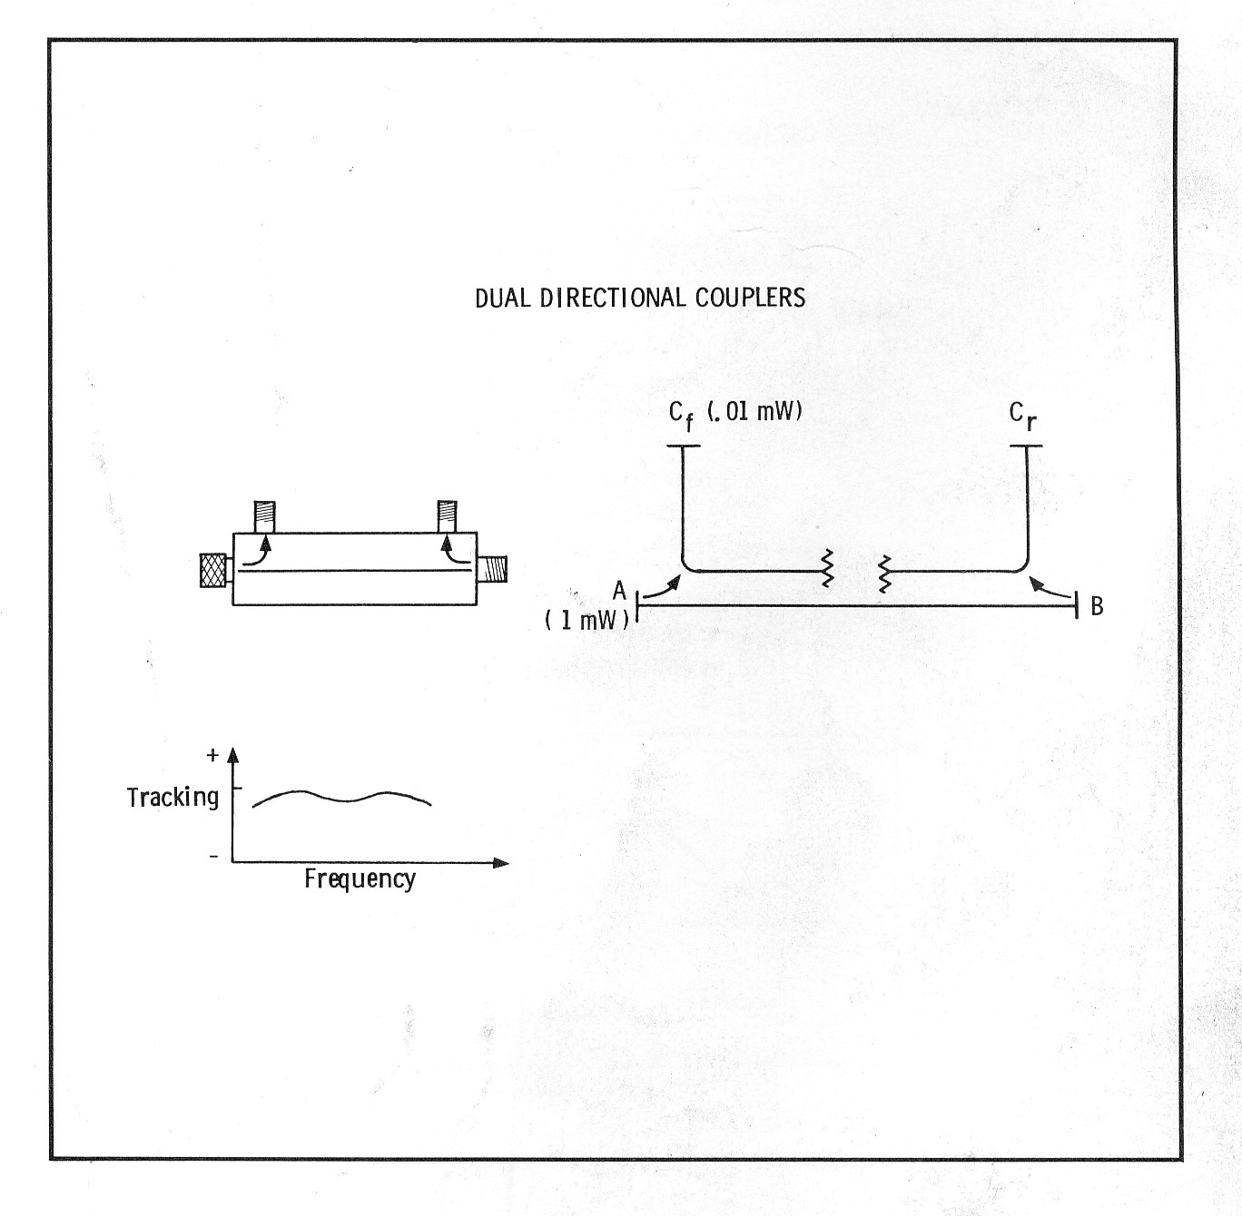

Slide 19
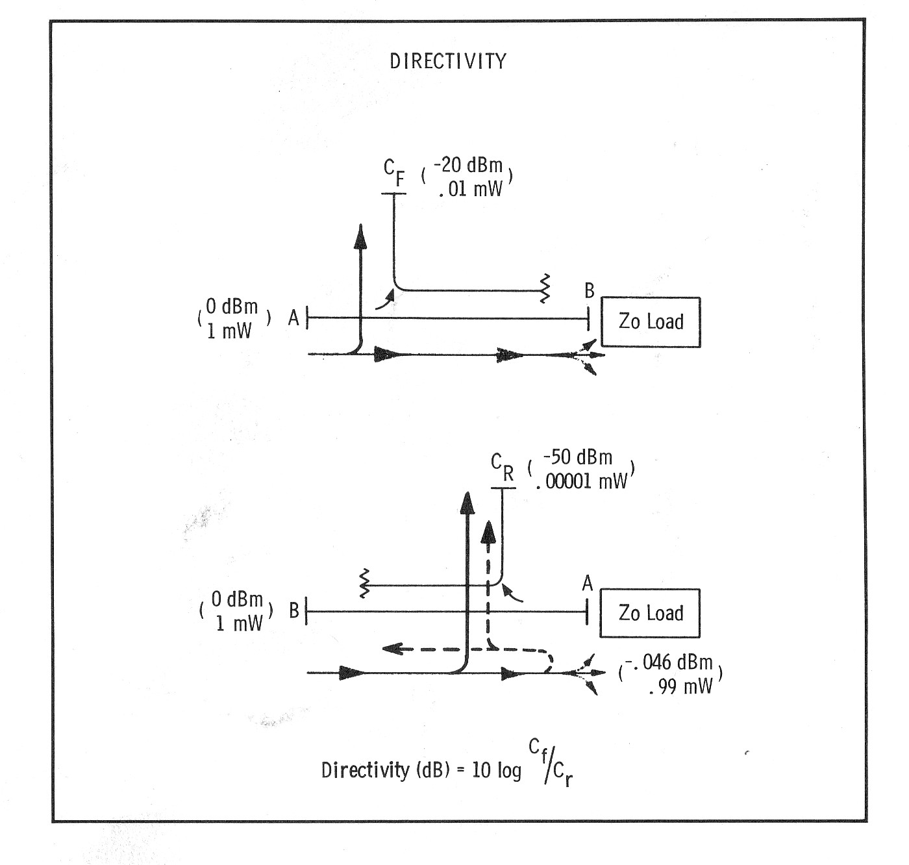

Slide 20
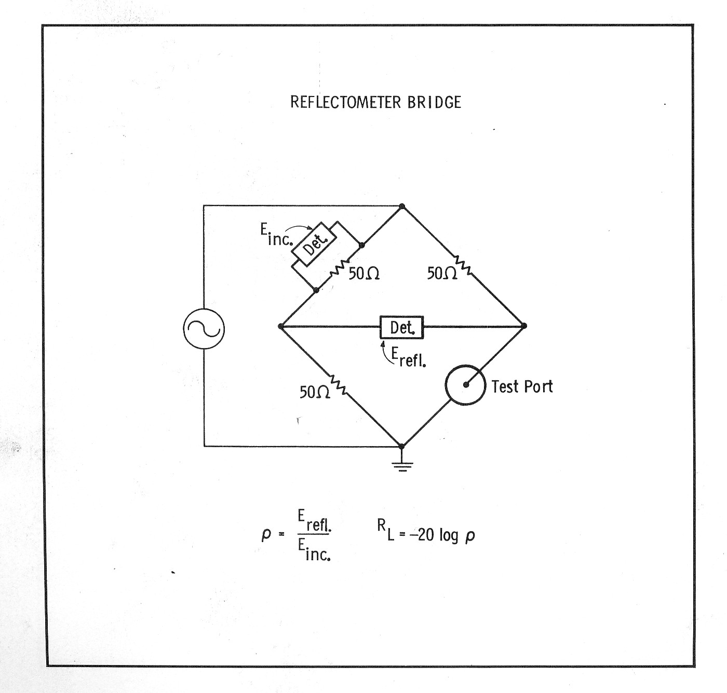

Slide 21
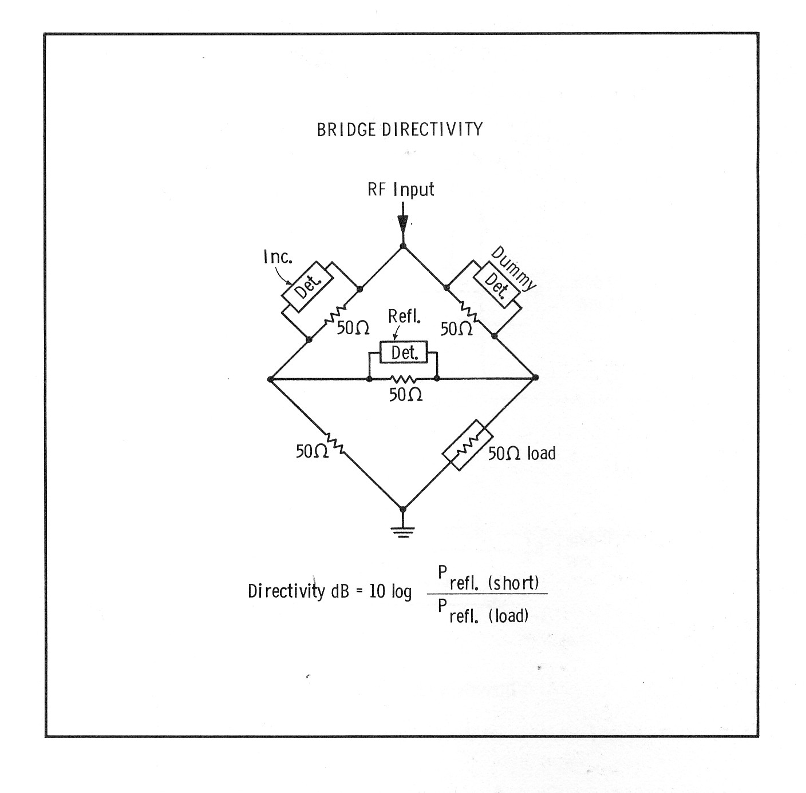

Slide 22
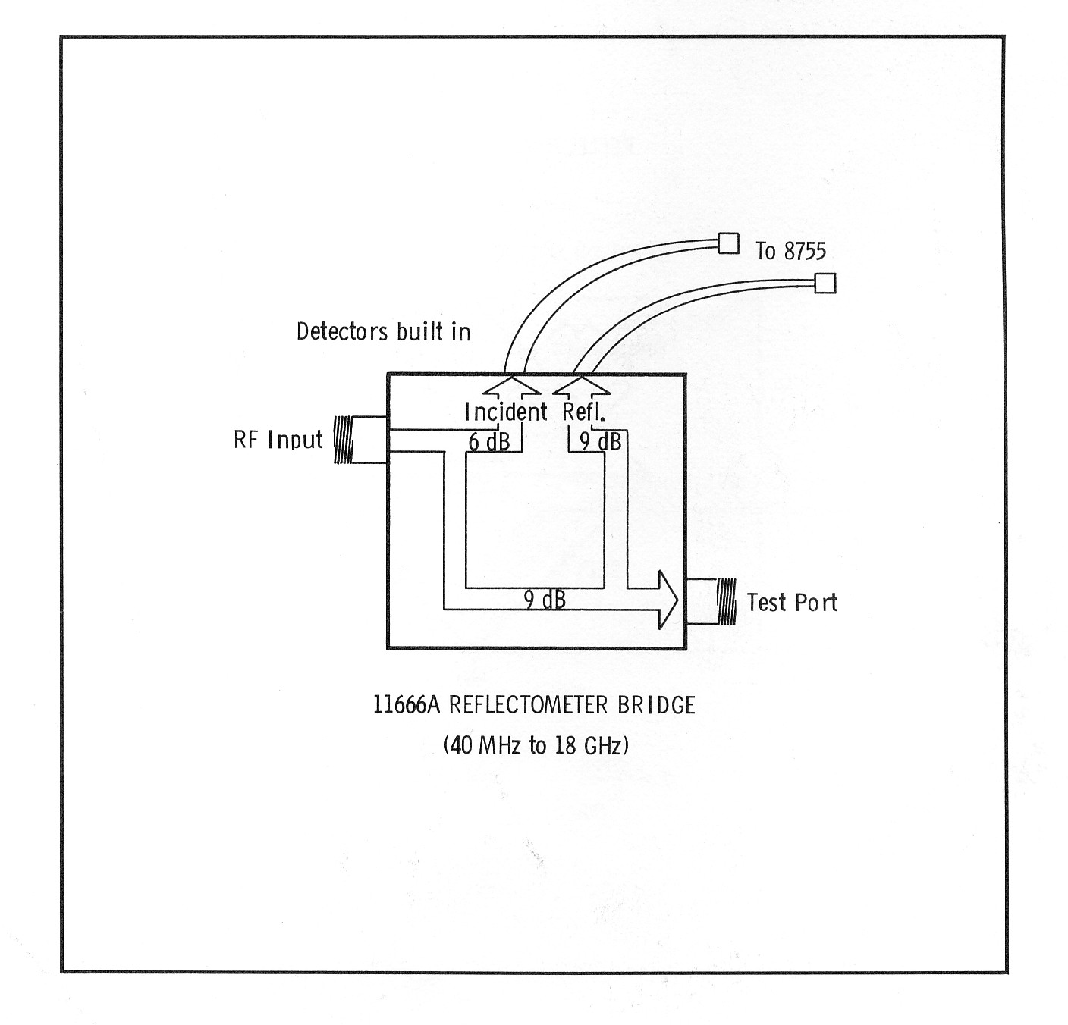

Slide 23
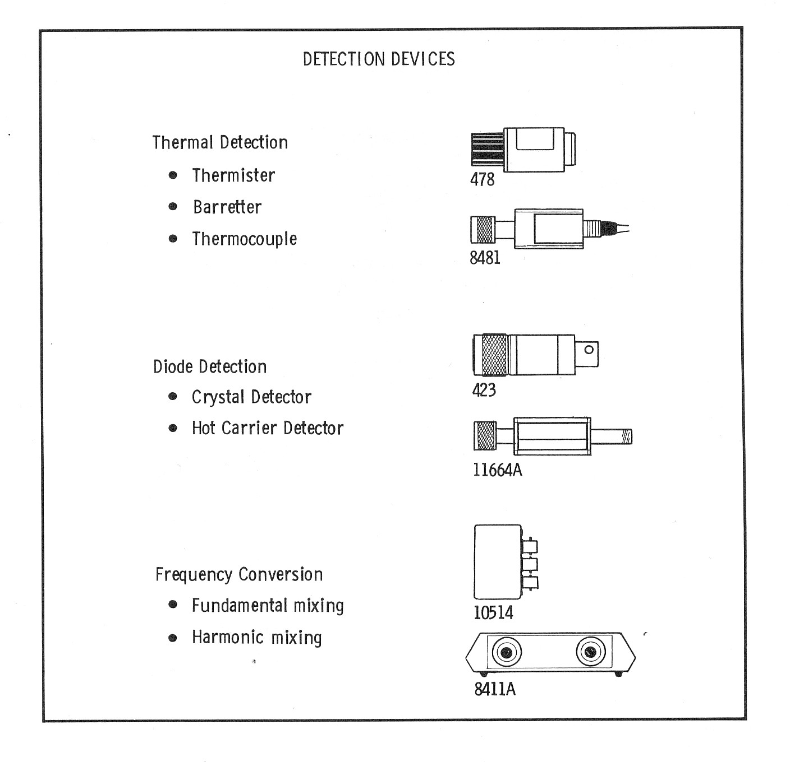

Slide 24
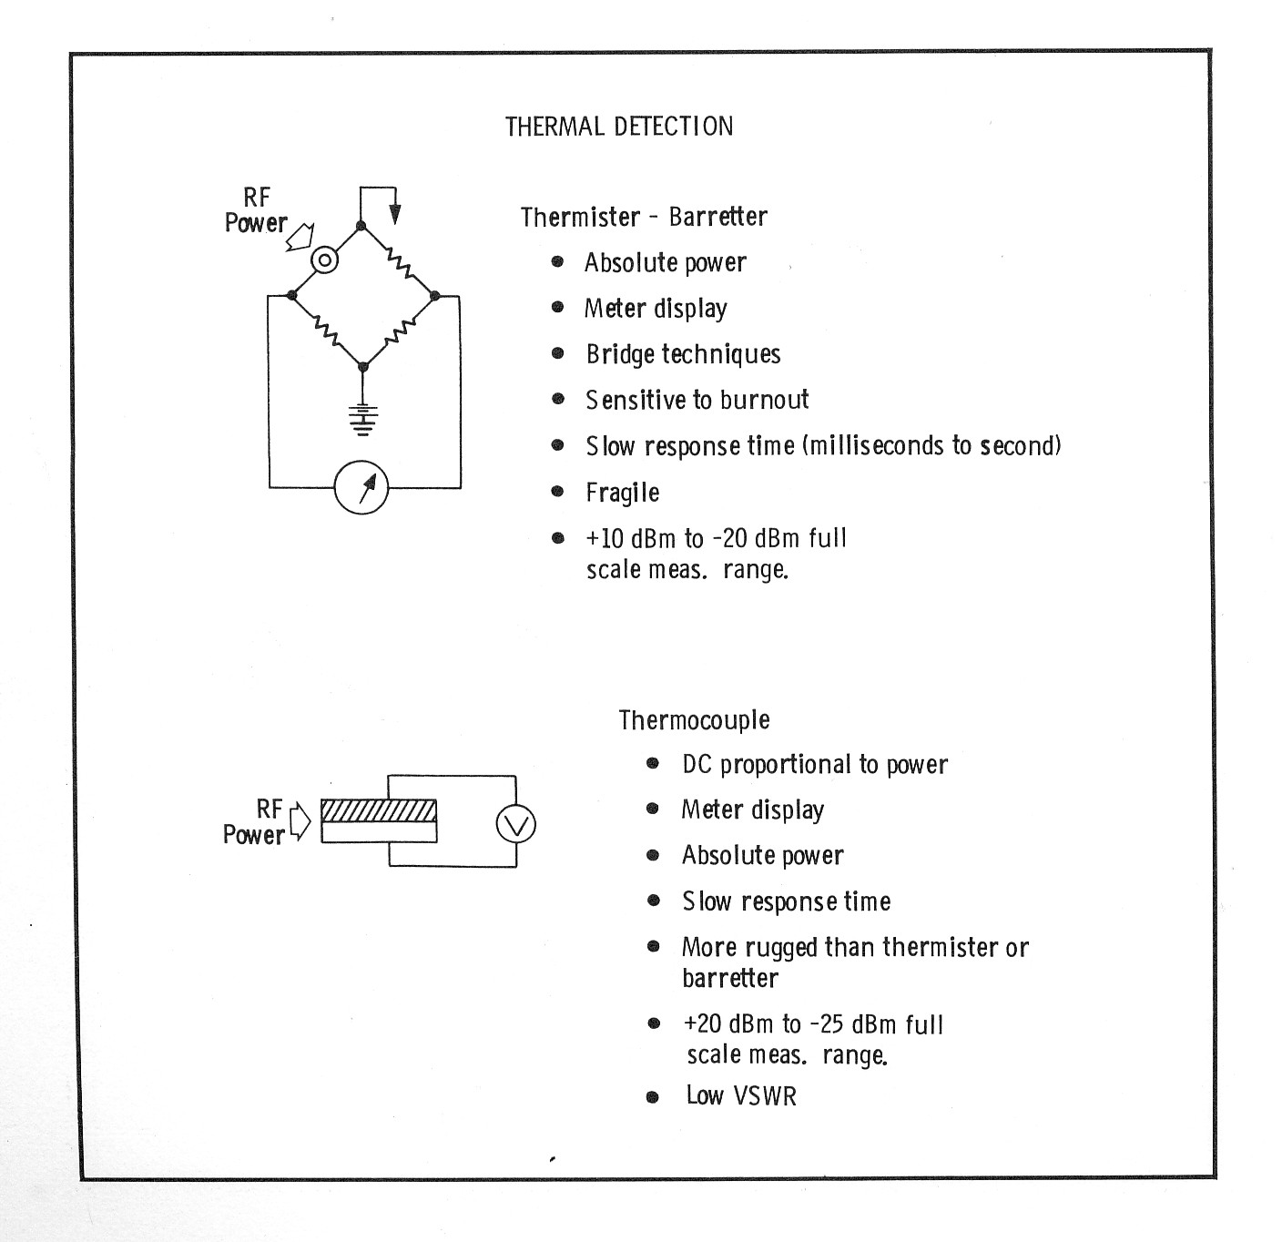

Slide 25
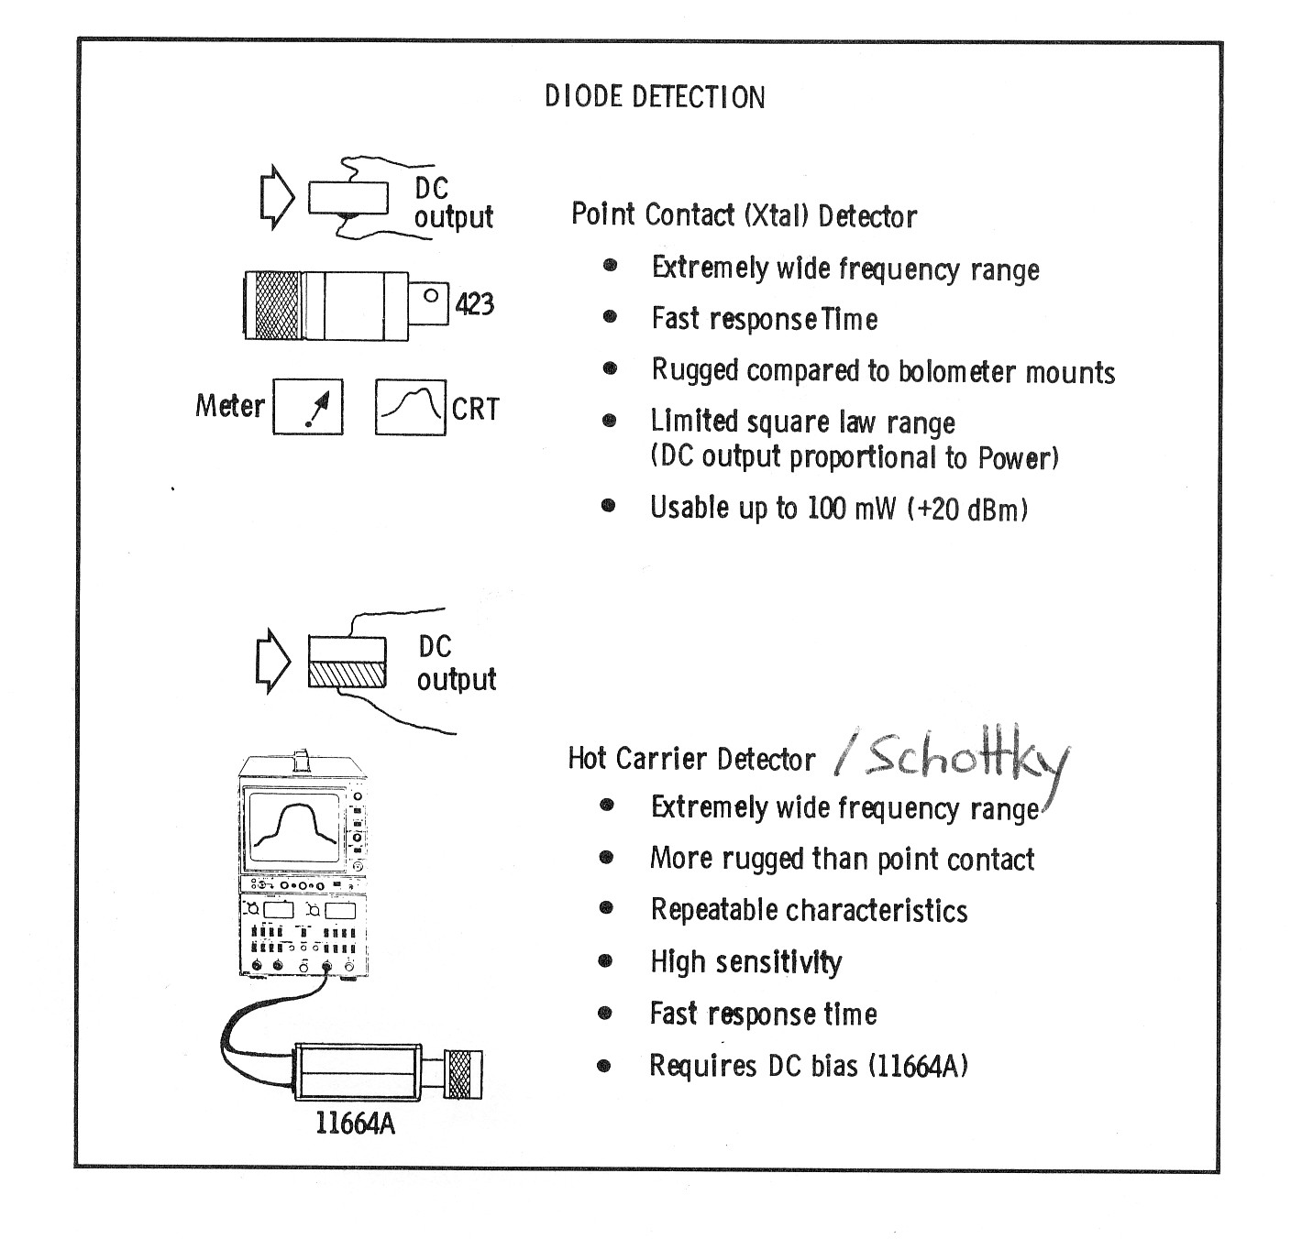

Slide 26
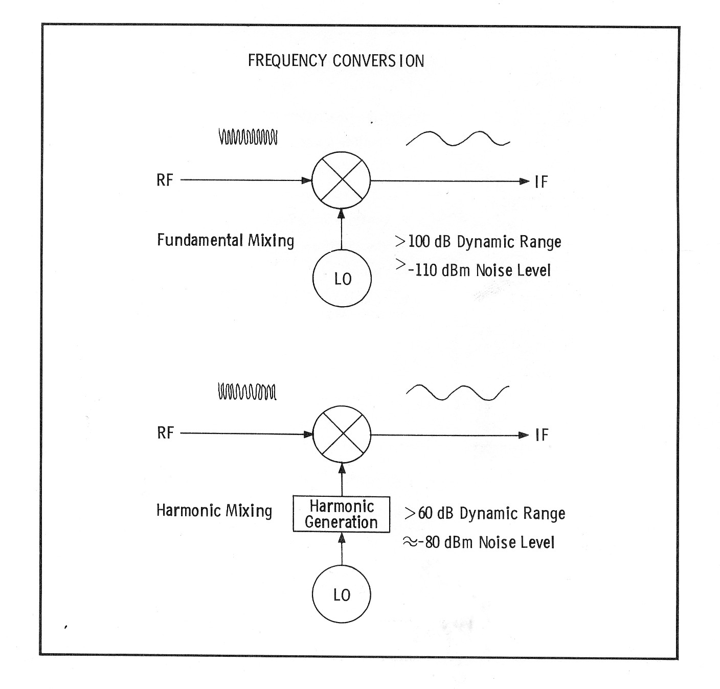

Slide 27
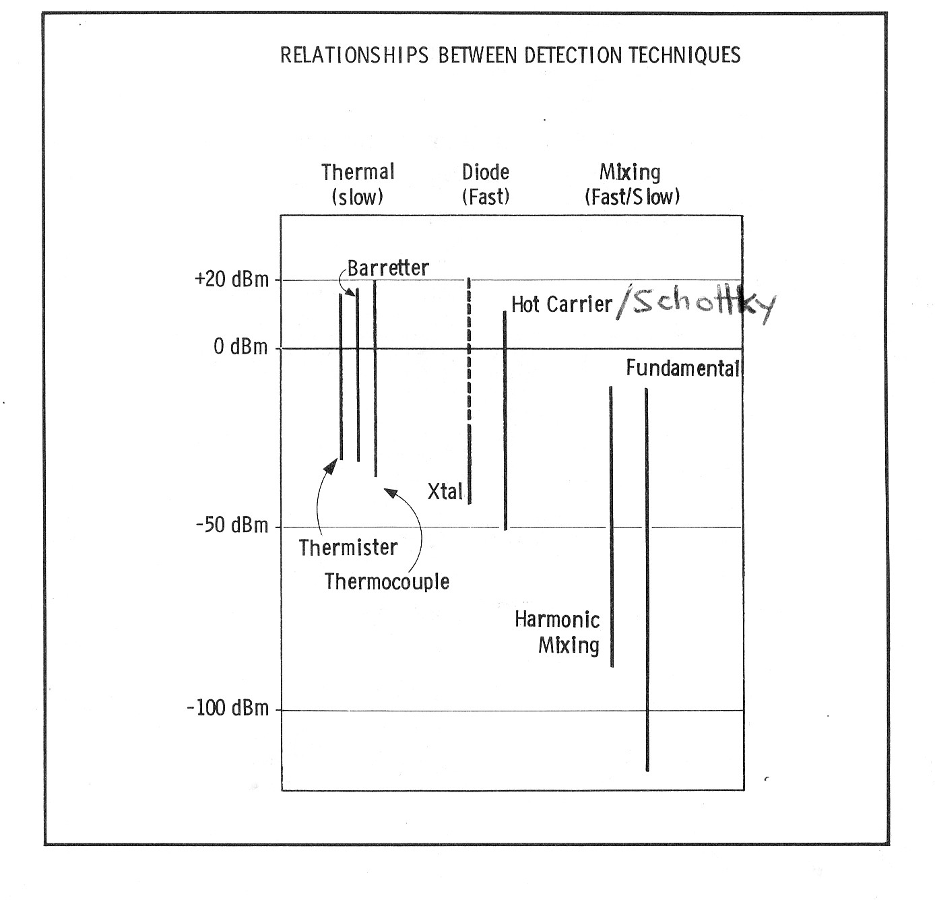

Slide 28
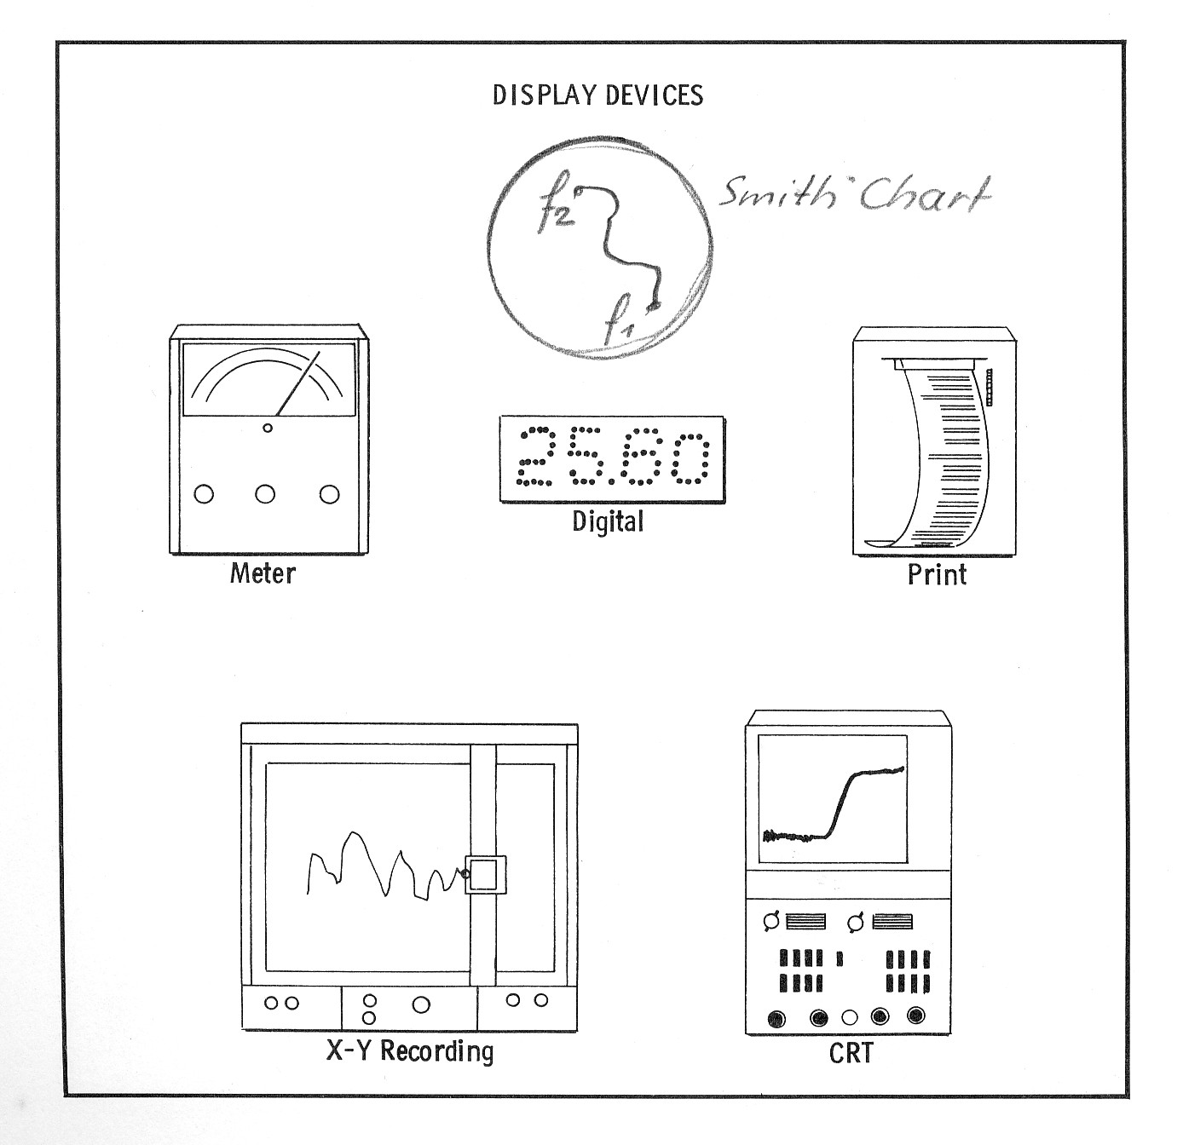

Slide 29
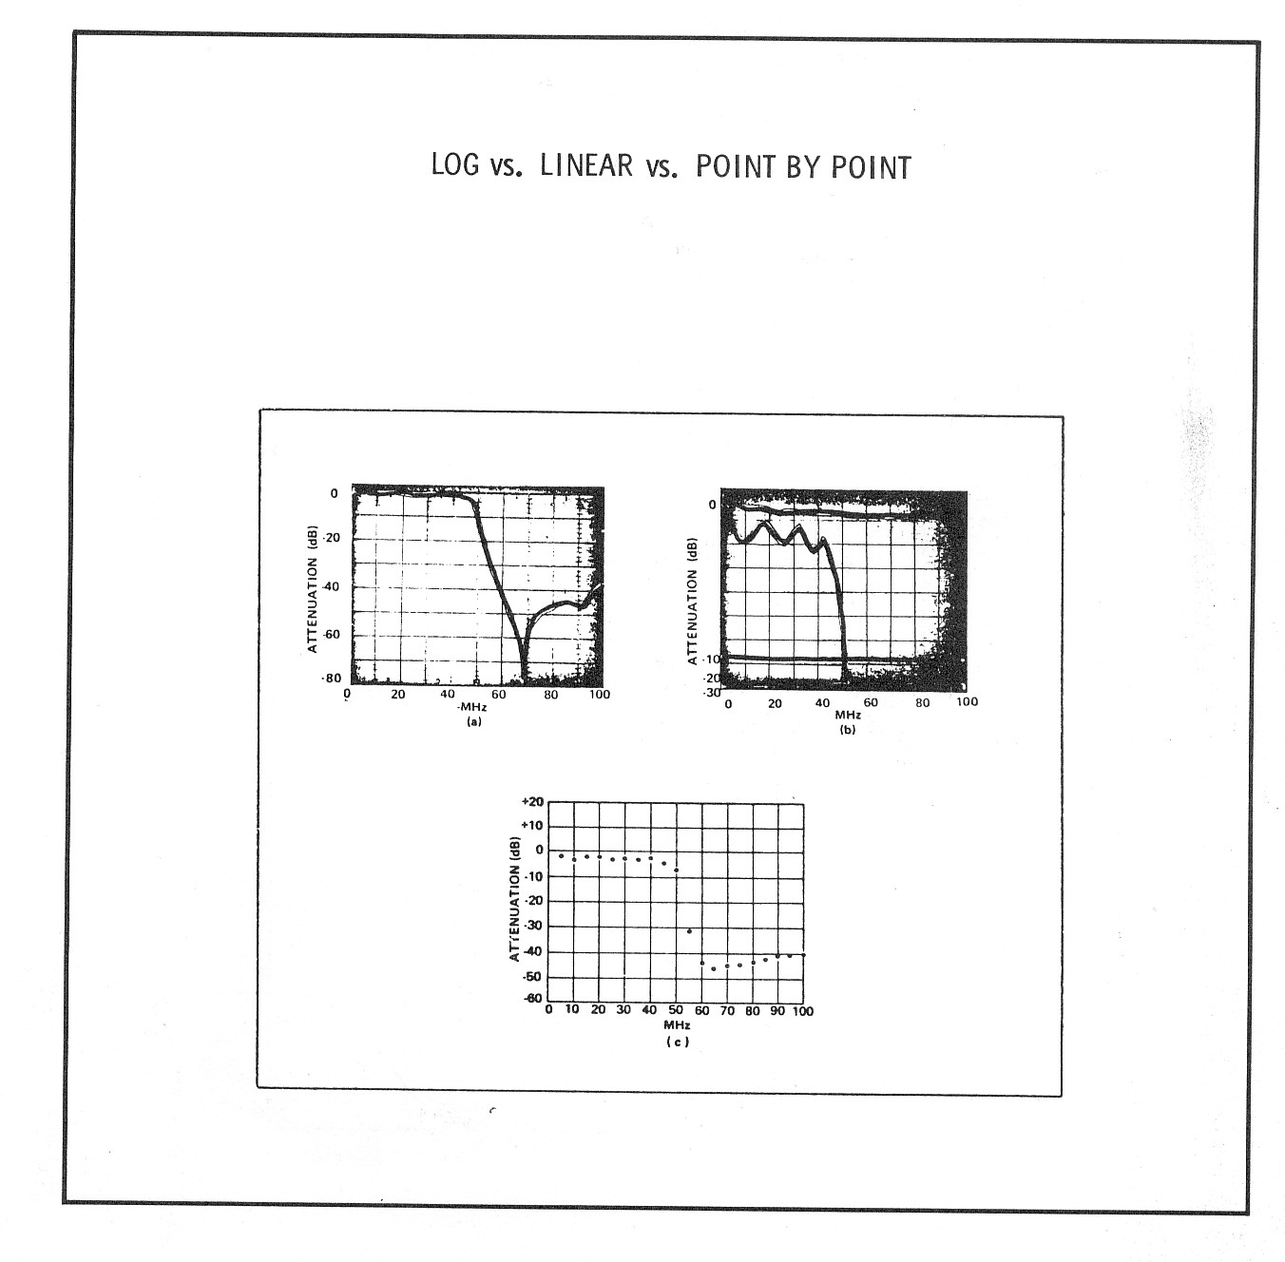

Slide 30
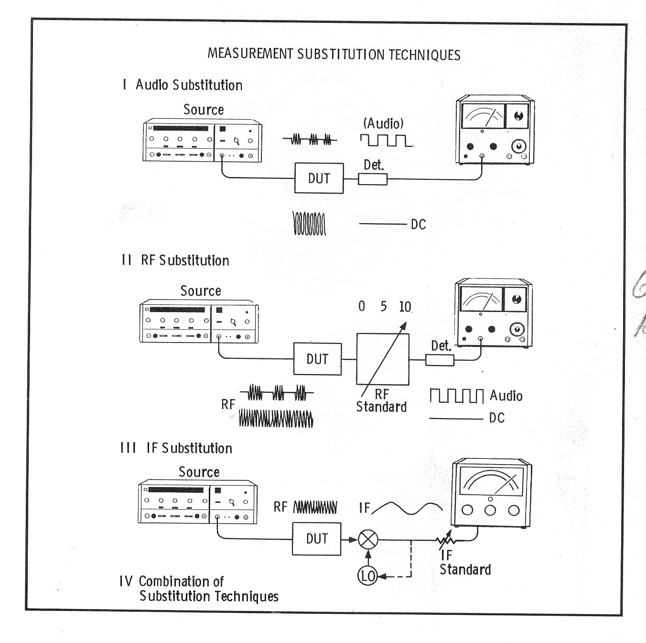

Slide 31
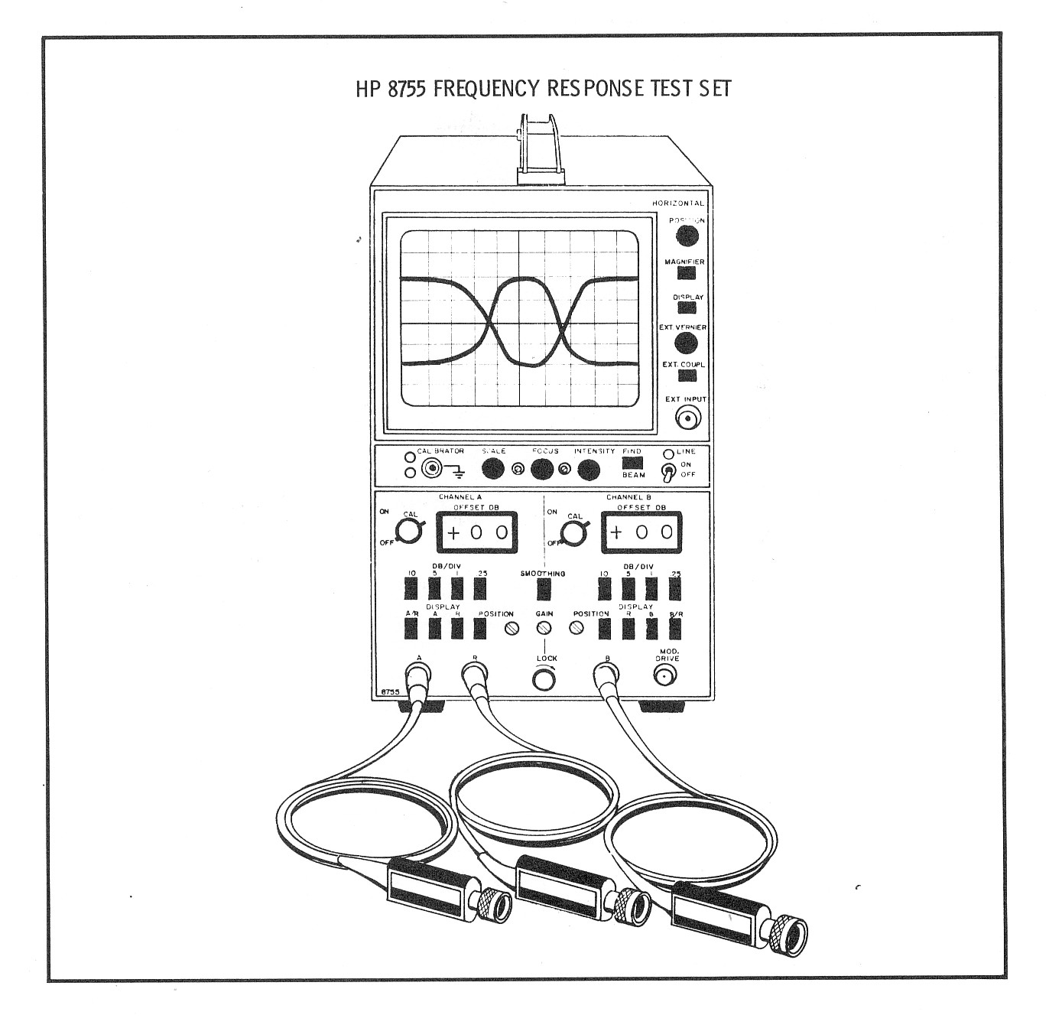

Slide 32
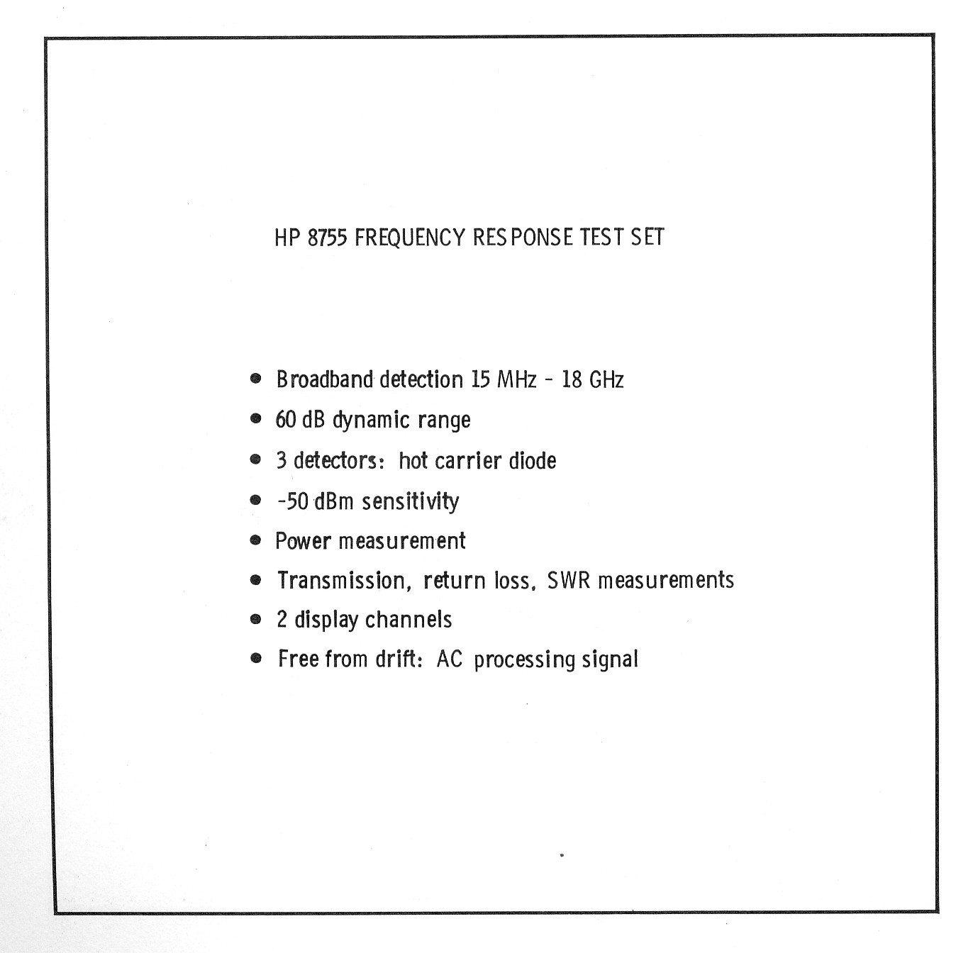

Slide 33
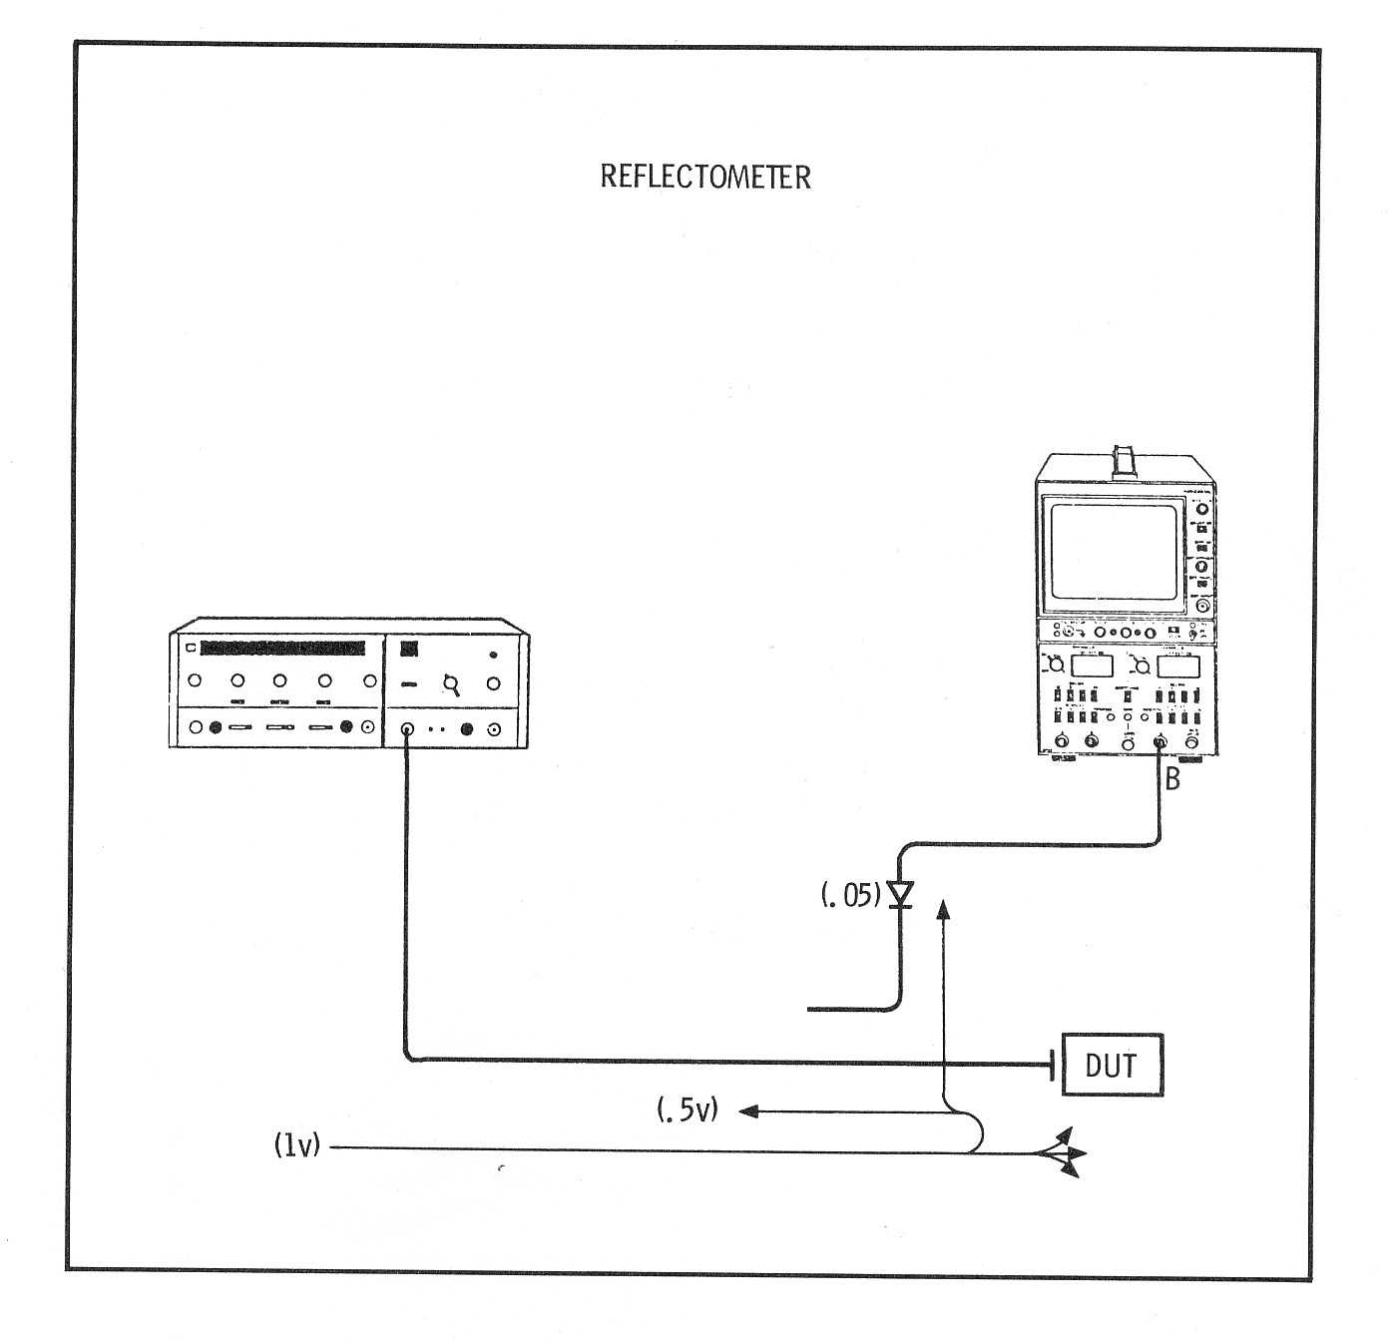

Slide 34
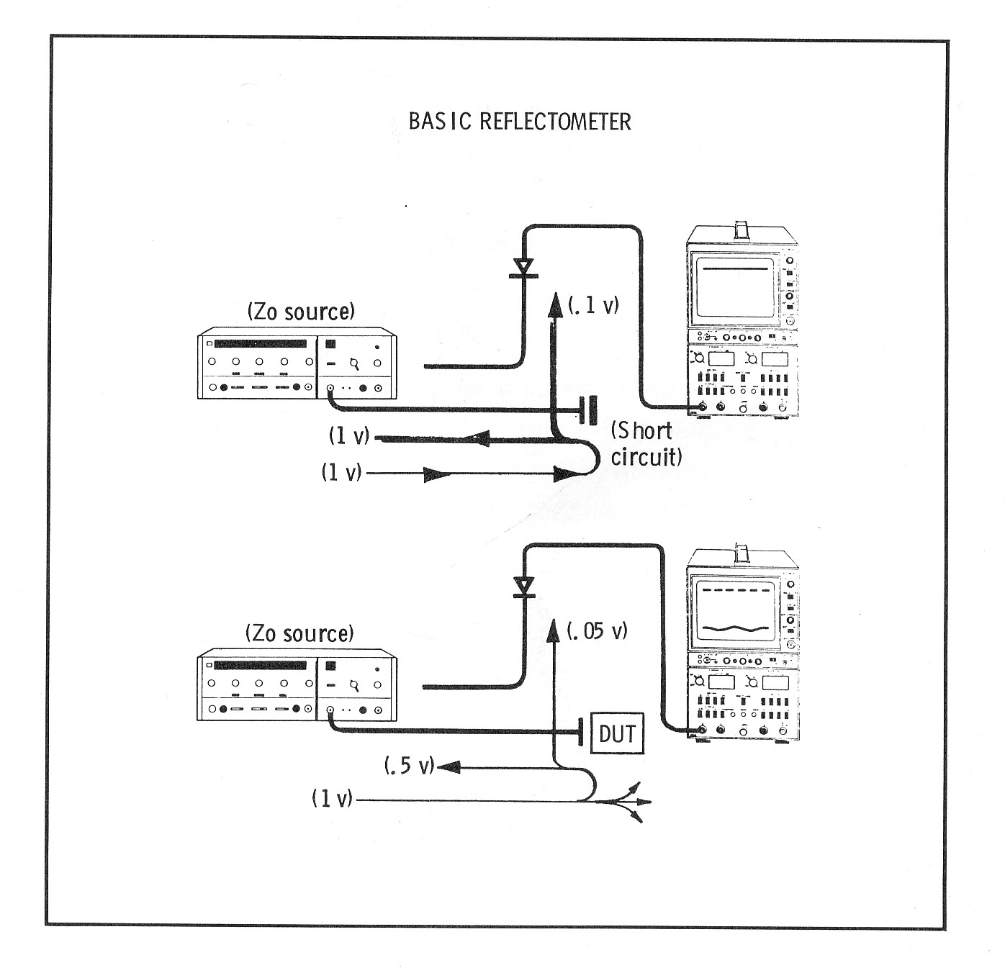

Slide 35
Impedansi Z = R atau XL atau XC (jika hanya satu yang ada)
Impedansi dalam serie hanya Z = √(R² + X²) (Jika R dan salah satu jenis X keduanya ada)
Impedansi dalam serie hanya Z = √(R² + (|XL - XC|)²) (Jika R, XL, dan XC semuanya ada)
Impedansi dalam suatu rangkaian = R + jX
(j adalah bilangan imajiner √(-1)) Resistansi R = I / ΔV
Inductive reactance XL = 2πƒL = ωL
Capacative reactance XC = 1 / 2πƒL

Slide 36
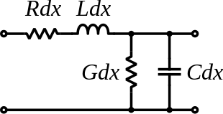


Representai rangkaian per satuan panjang saluran transmisi
Impedansi karakteristik saluran
Impedansi karakteristik saluran tanpa rugi2 (lossless line)

Slide 37


Koefisien pantul

Slide 38



VSWR Calculation
Mulai dengan formula VSWR :
Jika formula tsb dibalik, maka kita dapat menghitung г

Slide 39

Sekarang, reflection coefficient ini sebetulnya didefinisikan dalam tegangan, sebetulnya kita ingin tahu berapa daya yang dipantulkan
Dan jika dikonversikan ke decibel, maka:
Finally the power is either reflected or delivered to the antena.

Slide 40
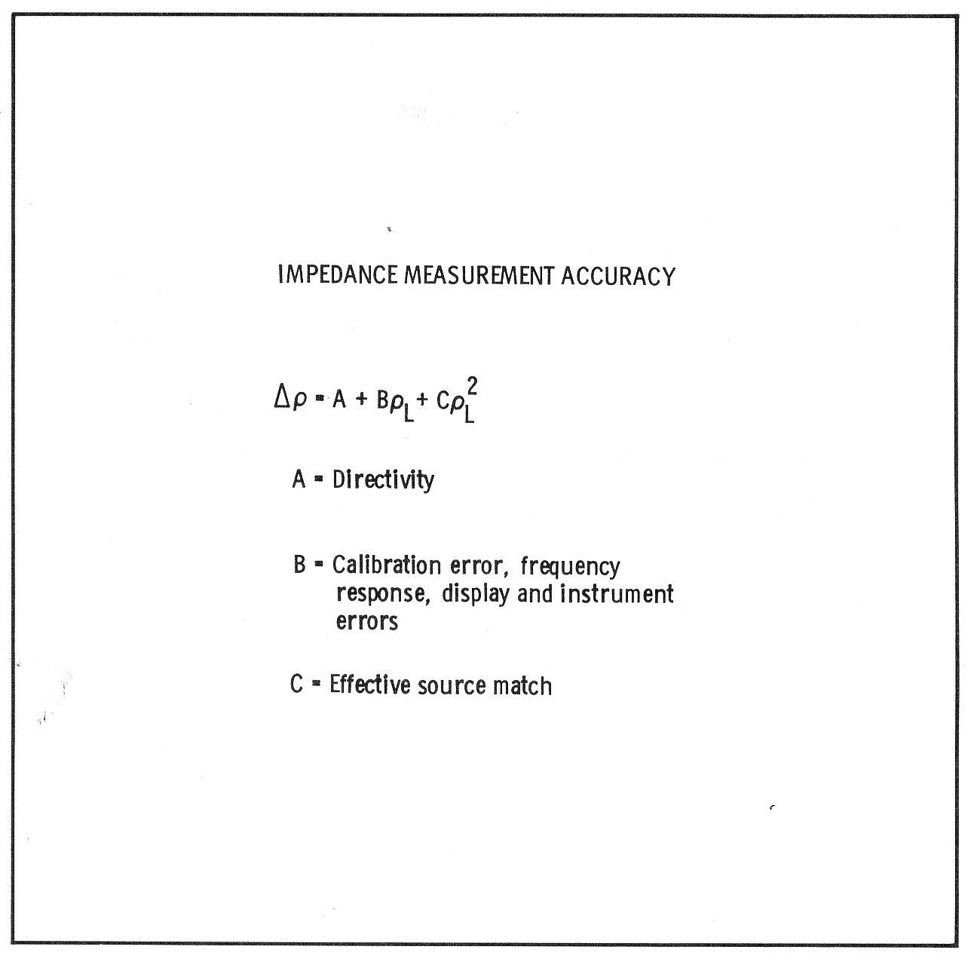

Slide 41
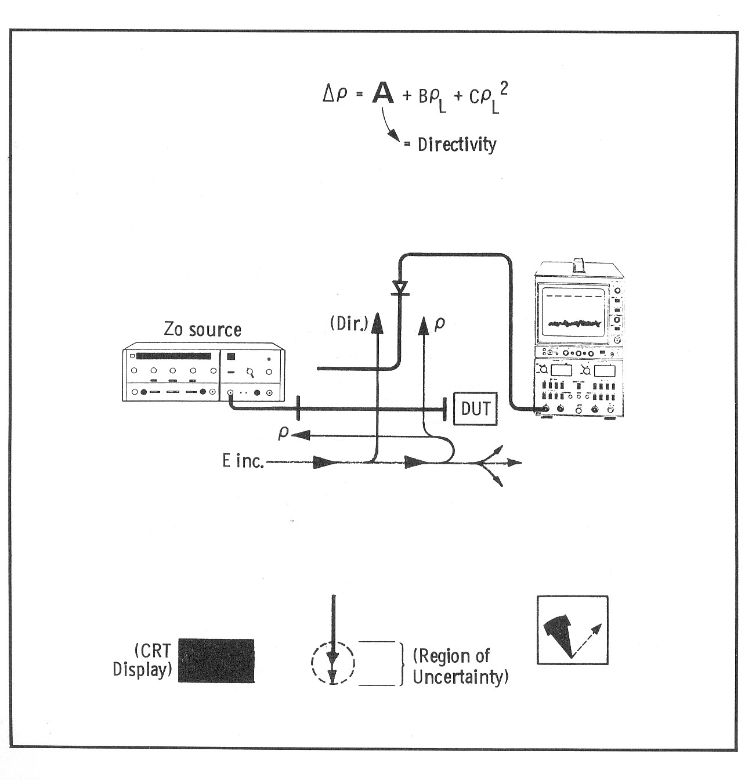

Slide 42
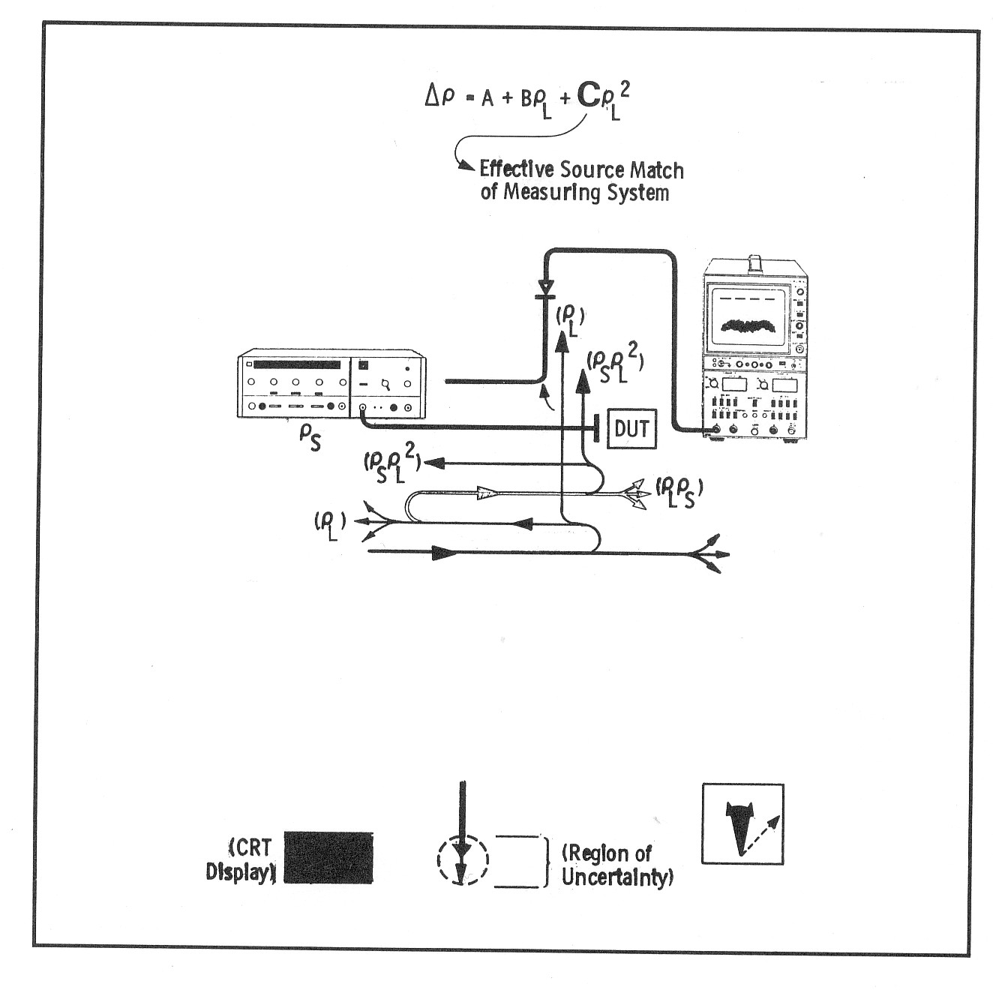

Slide 43
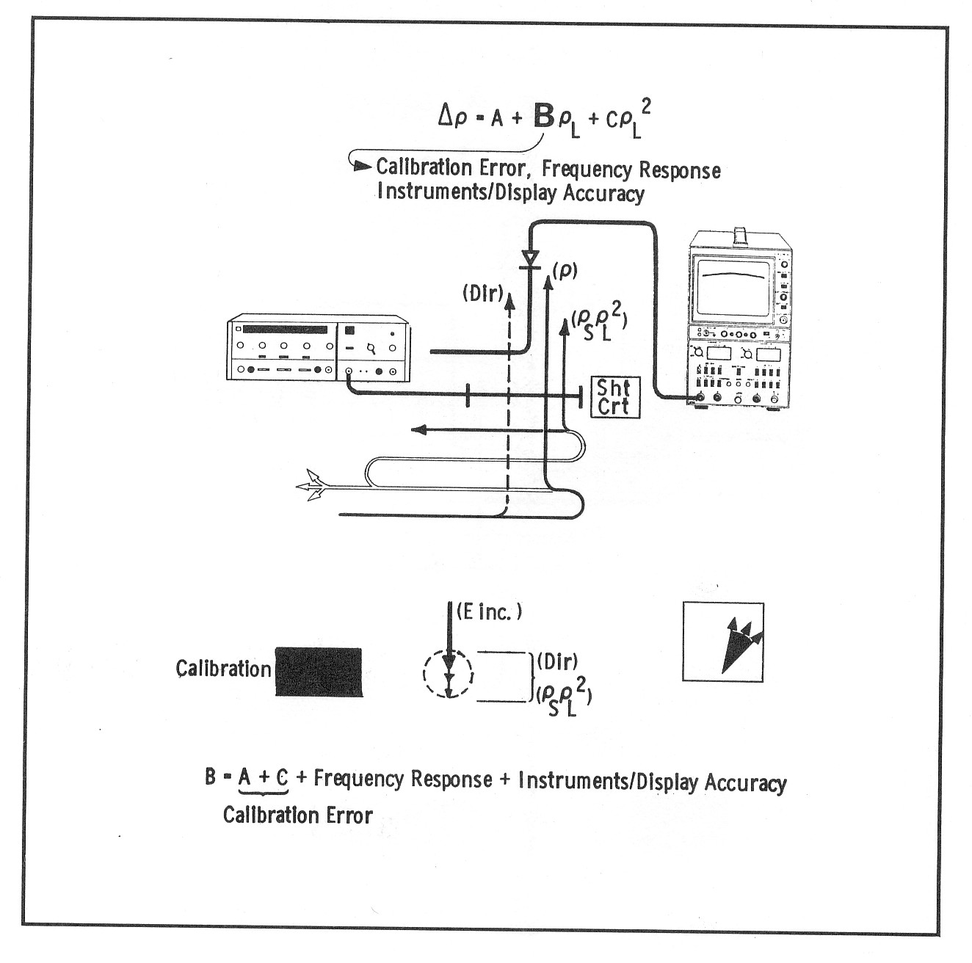

Slide 44
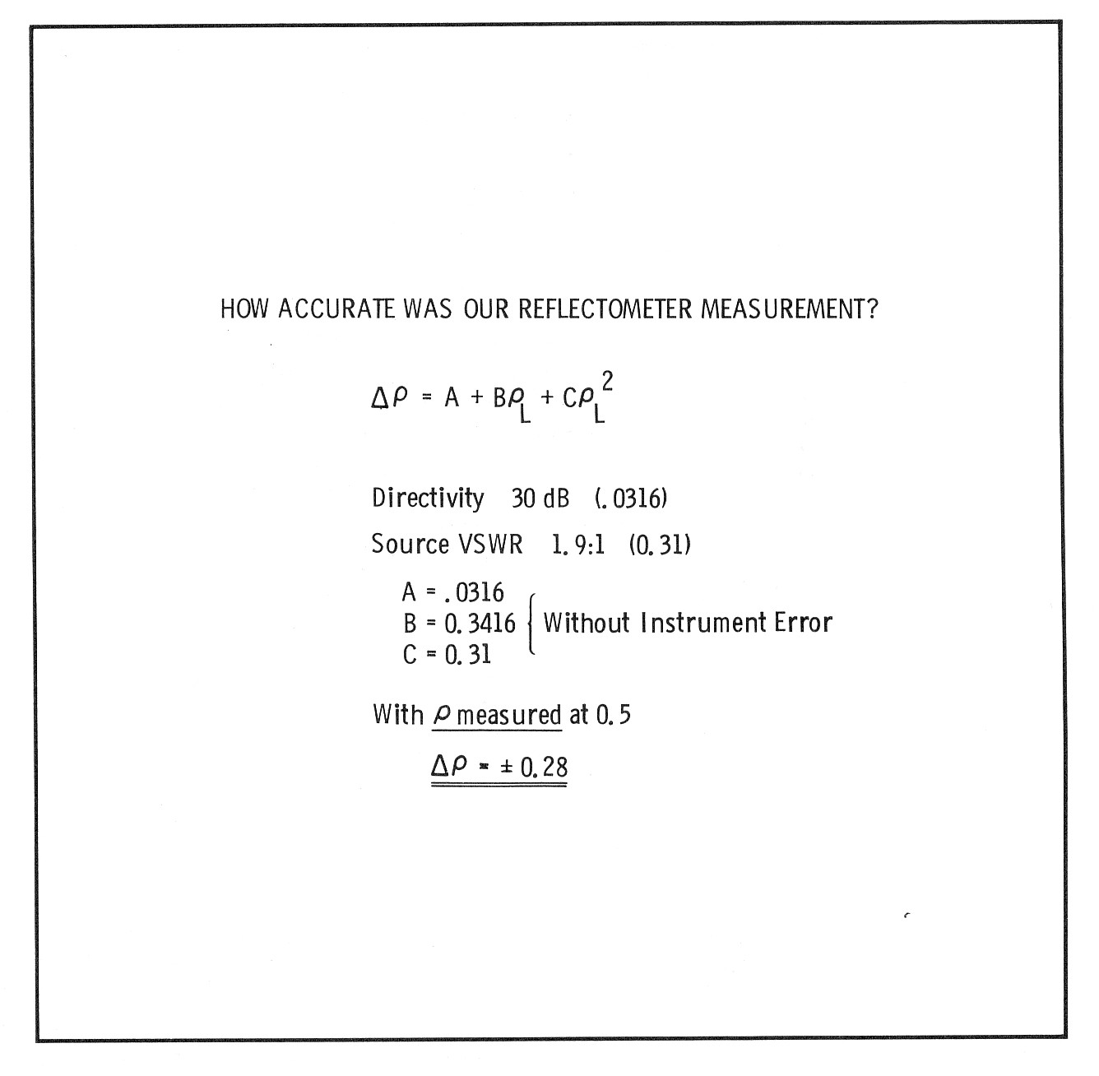

Slide 45
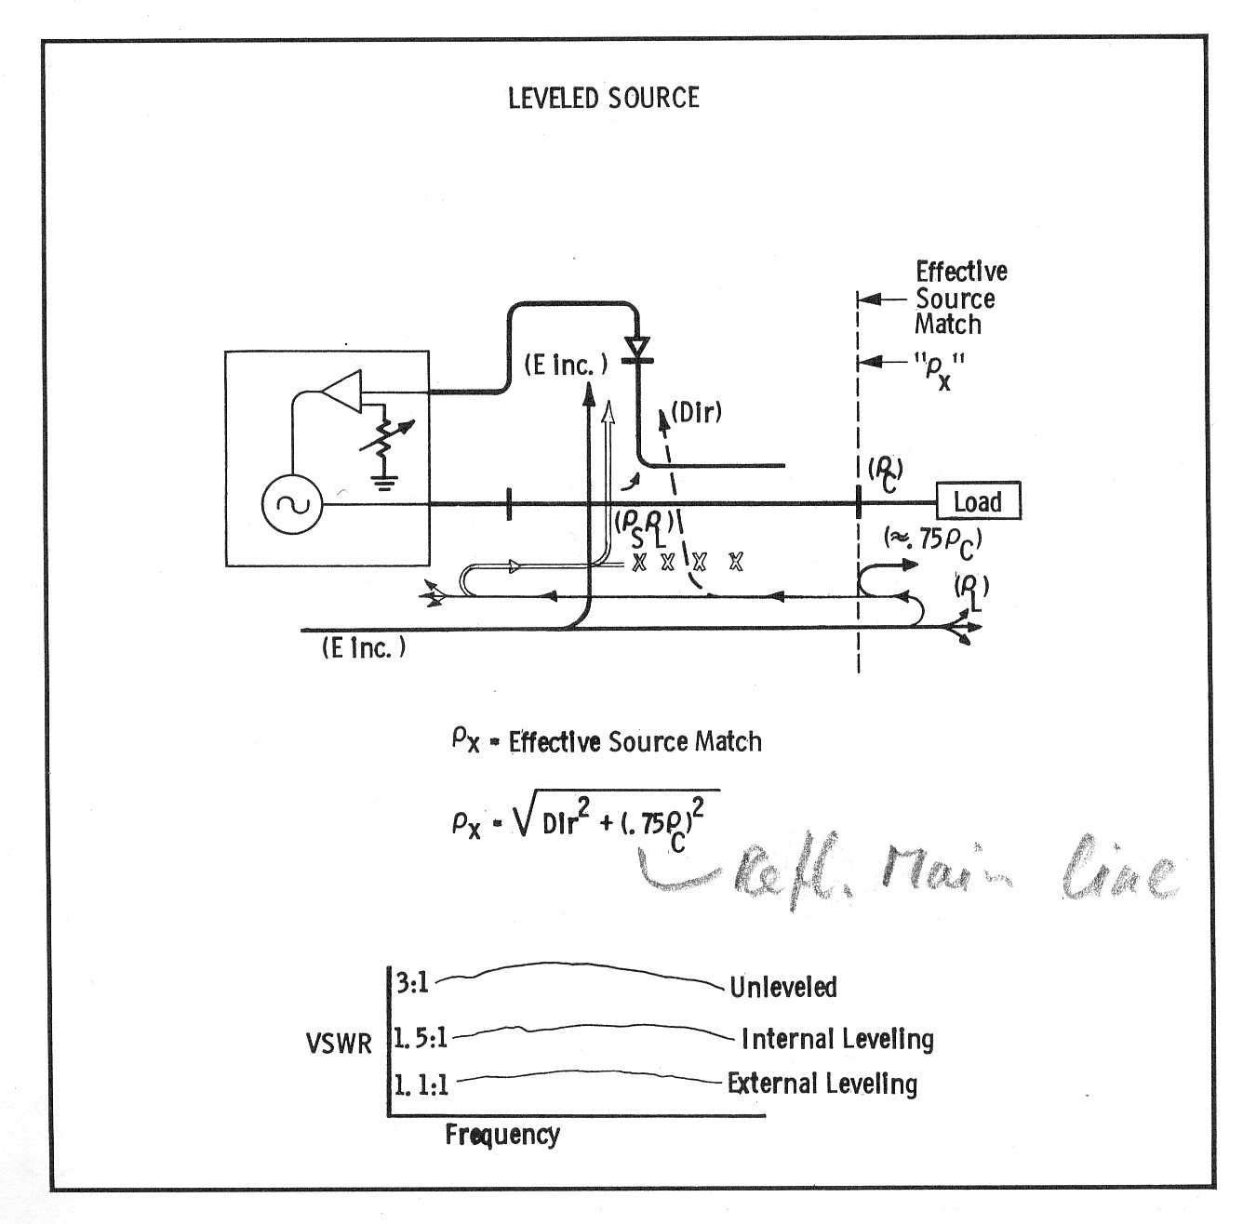

Slide 46
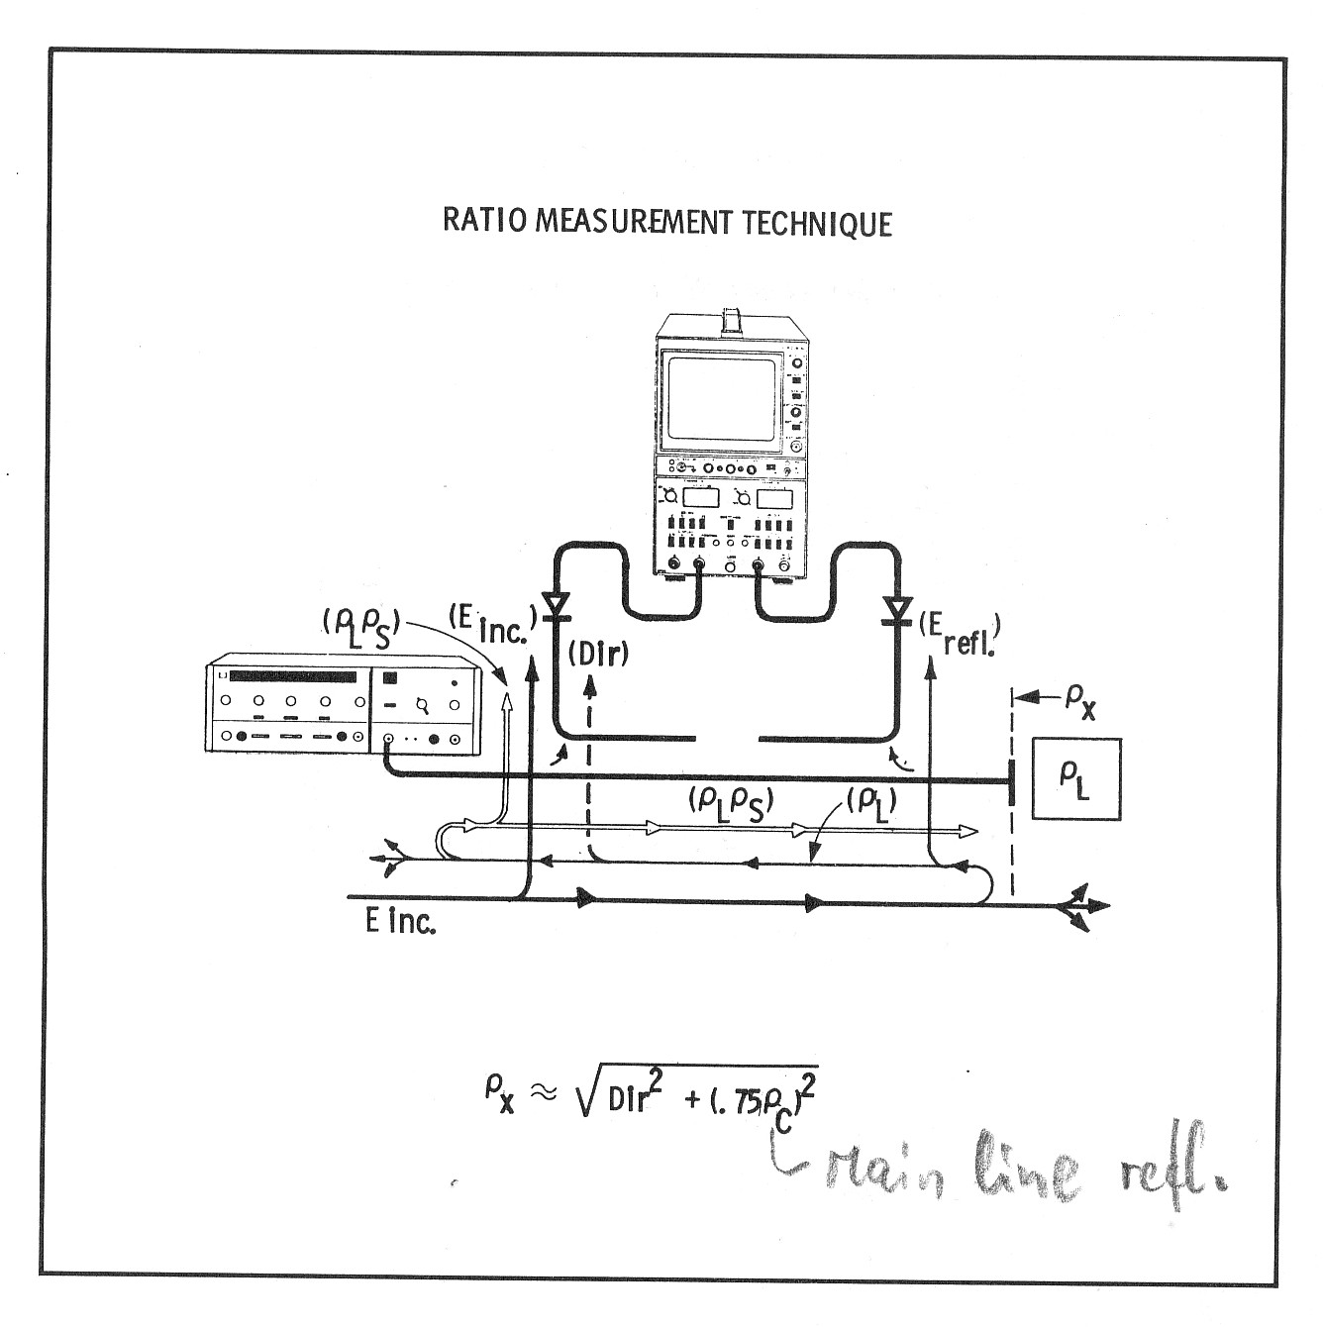

Slide 47
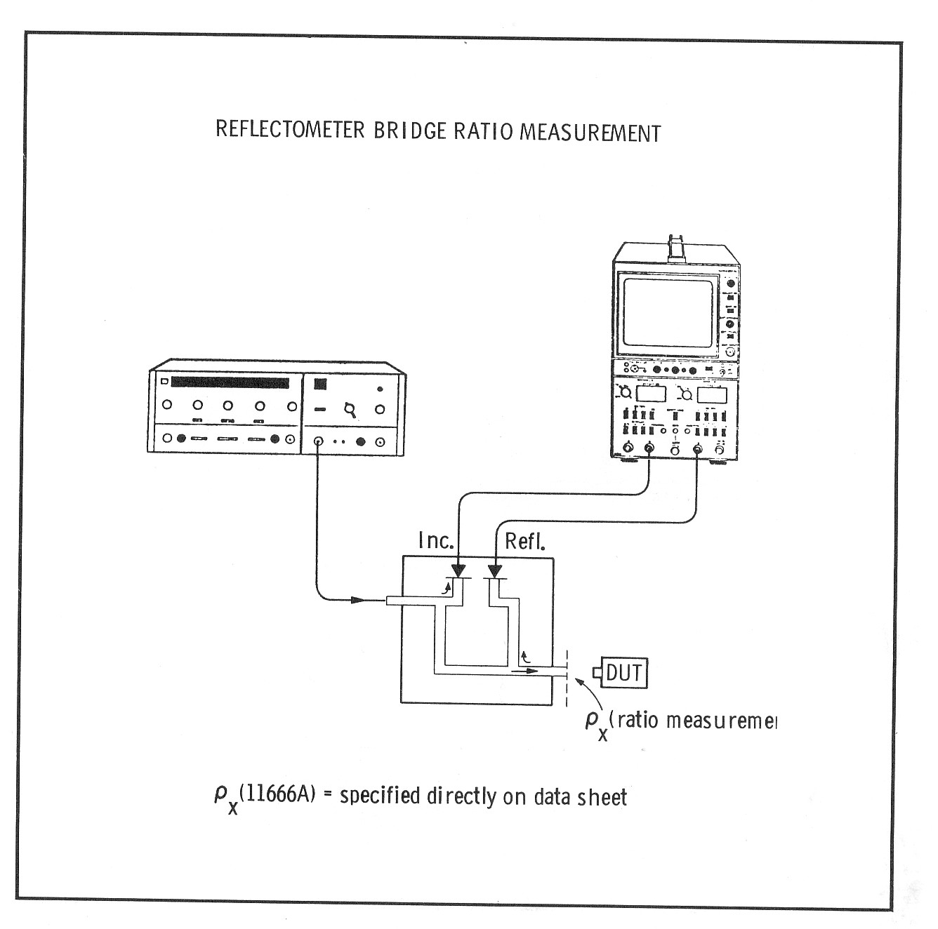

Slide 48
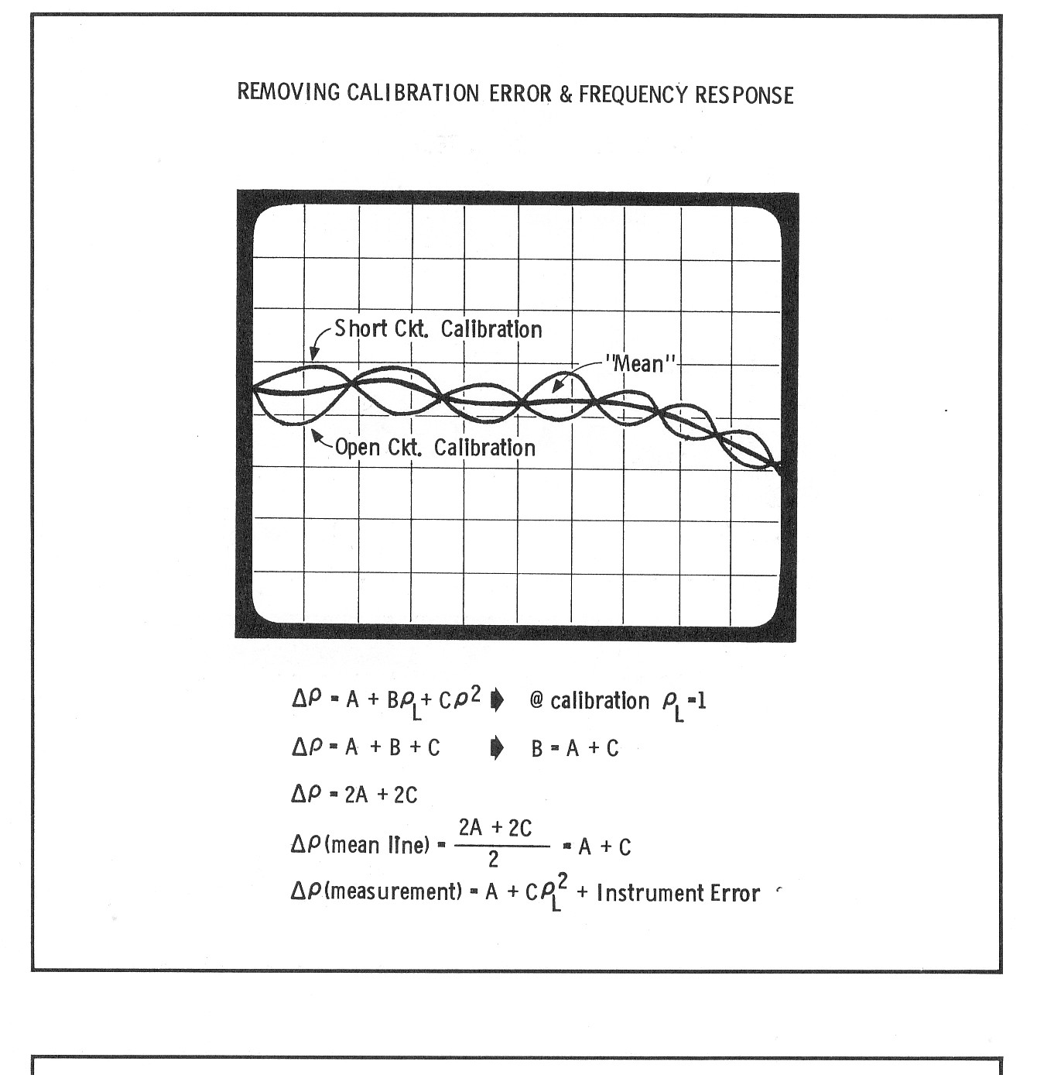

Slide 49
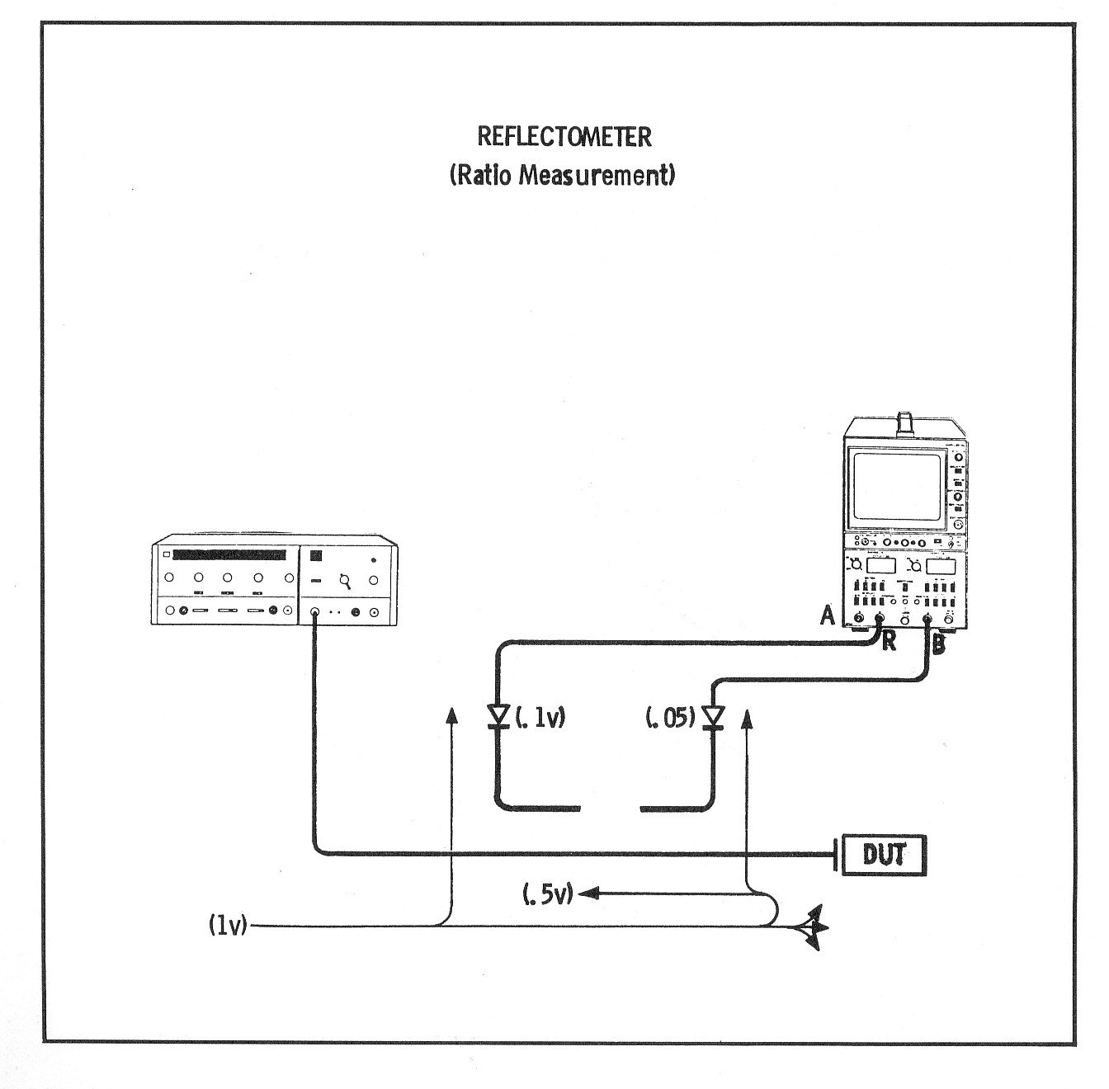

Slide 50
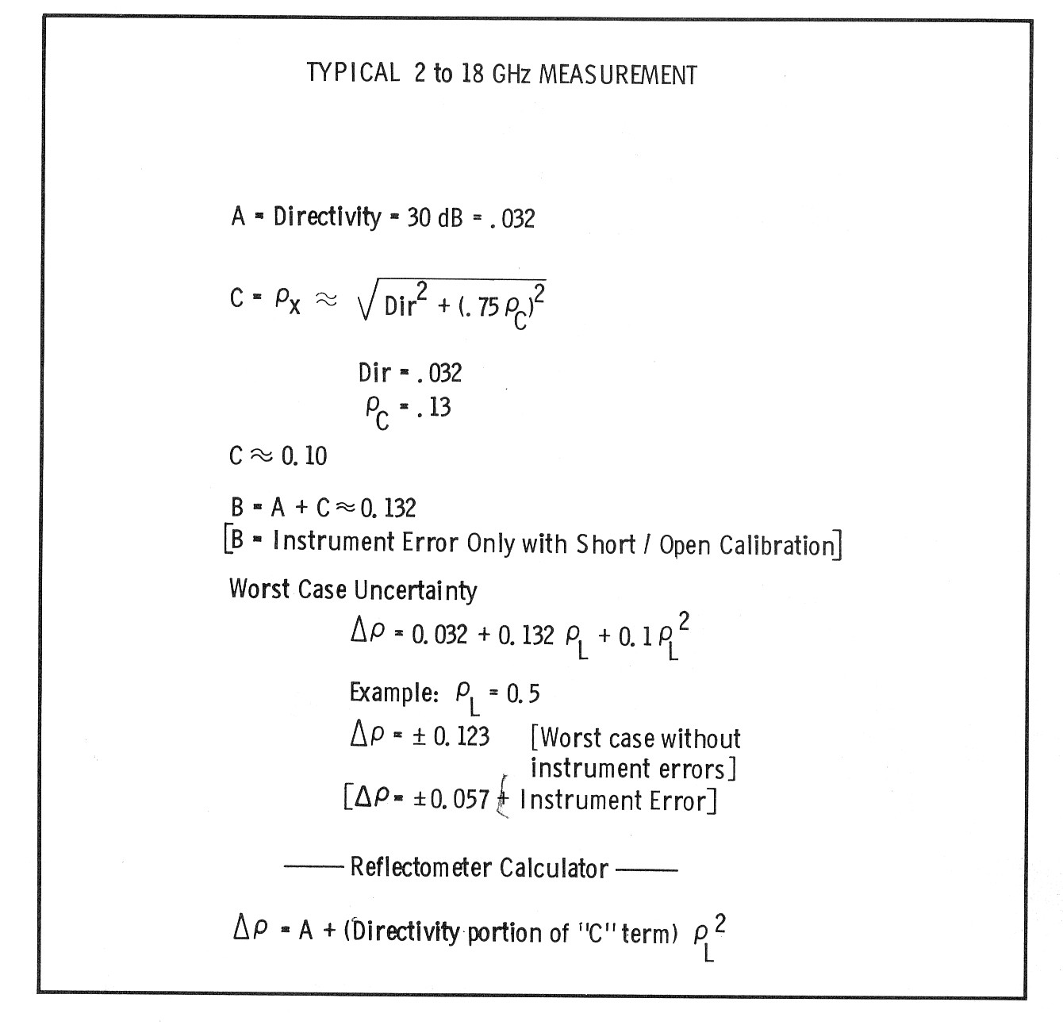

Slide 51
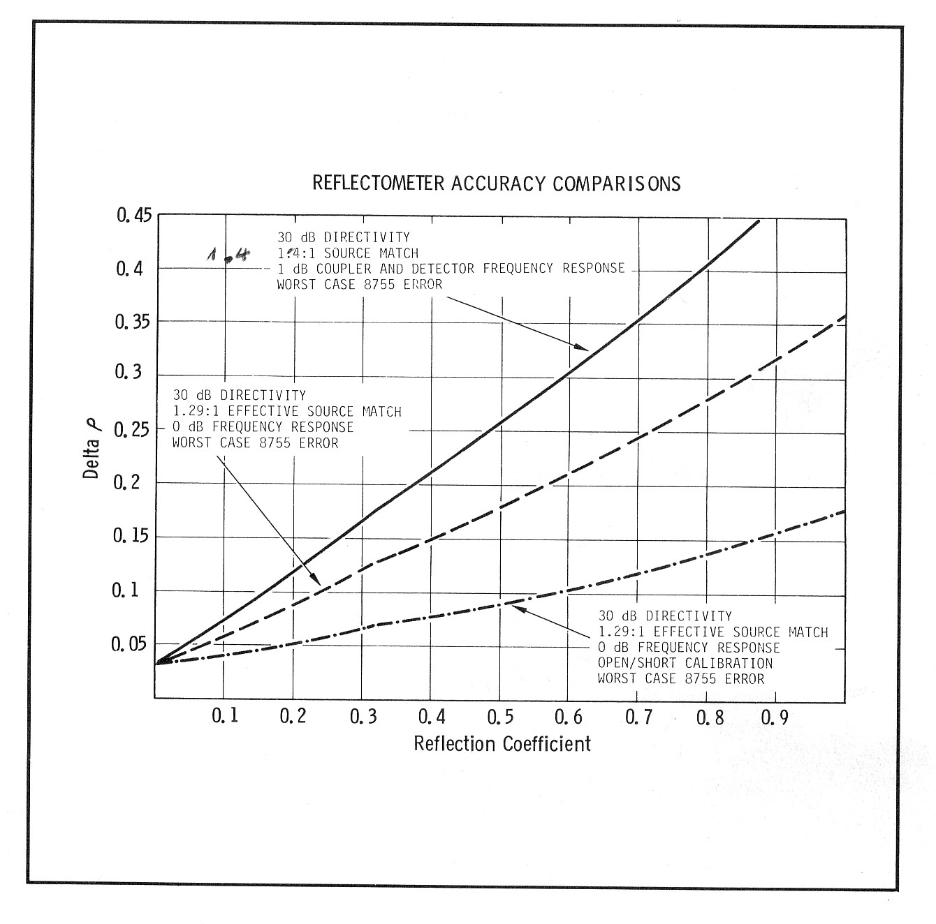

Slide 52
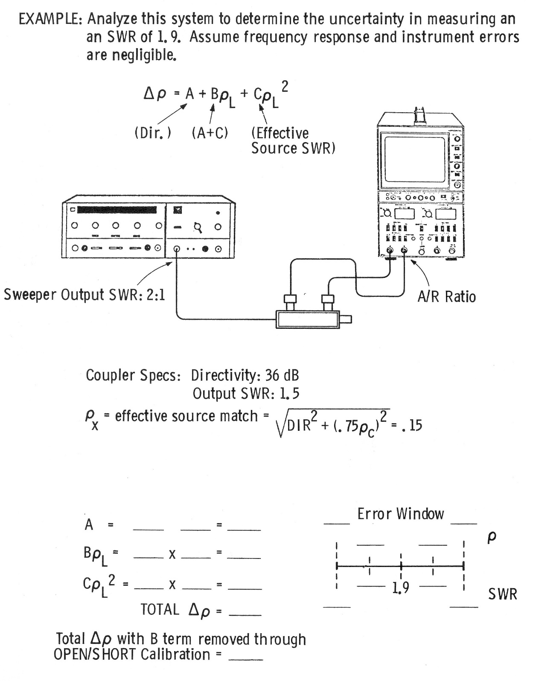

Slide 53
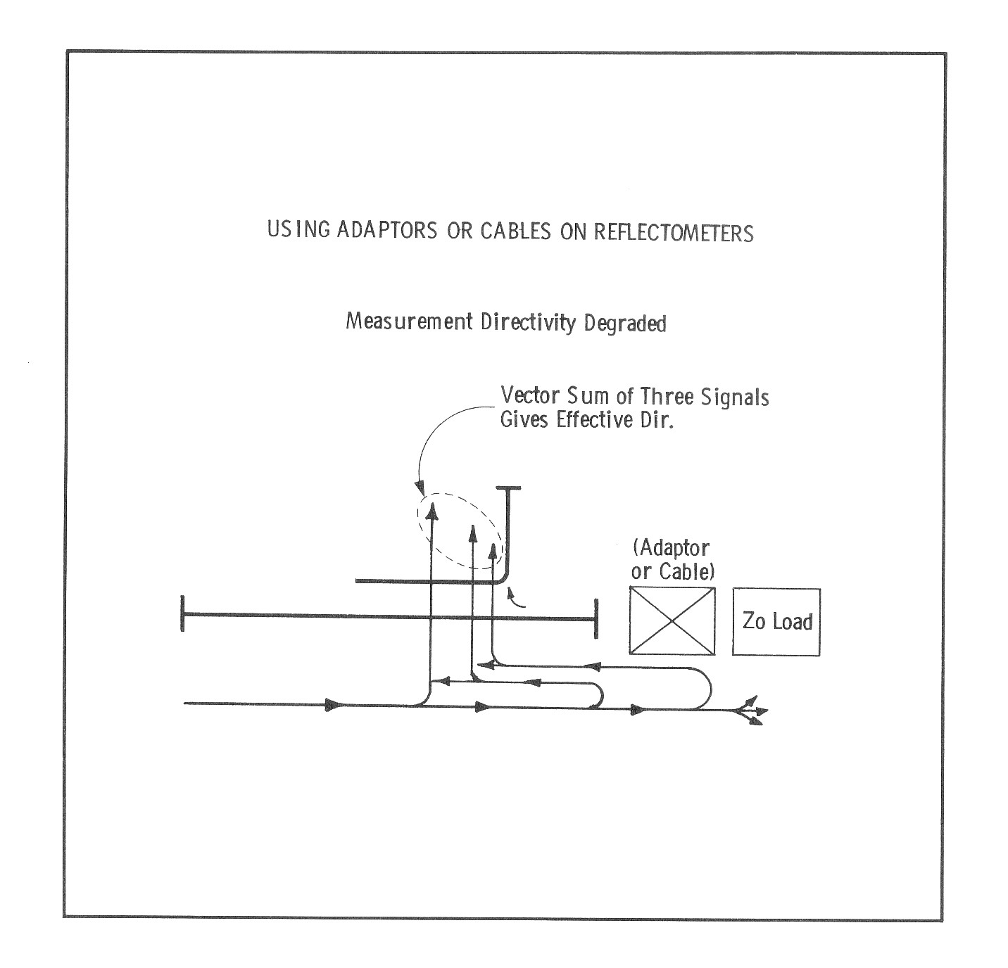

Slide 54
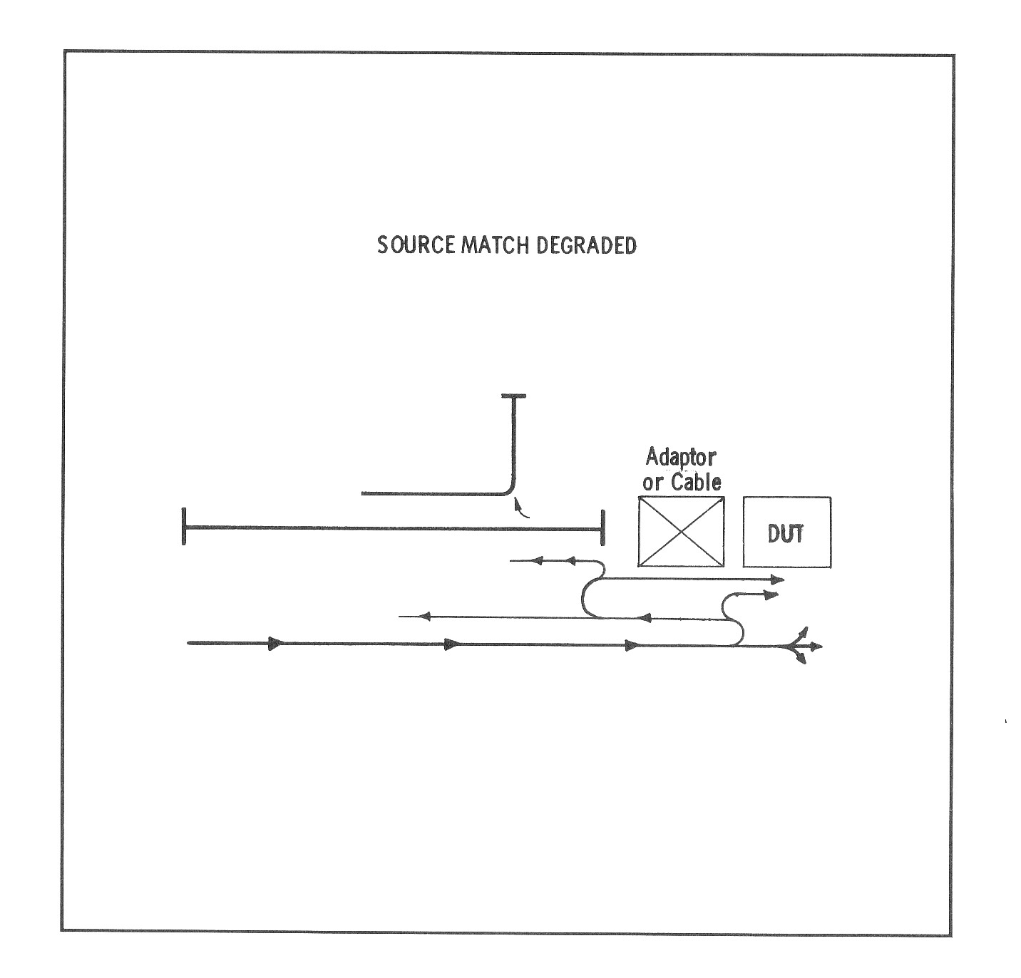

Slide 55
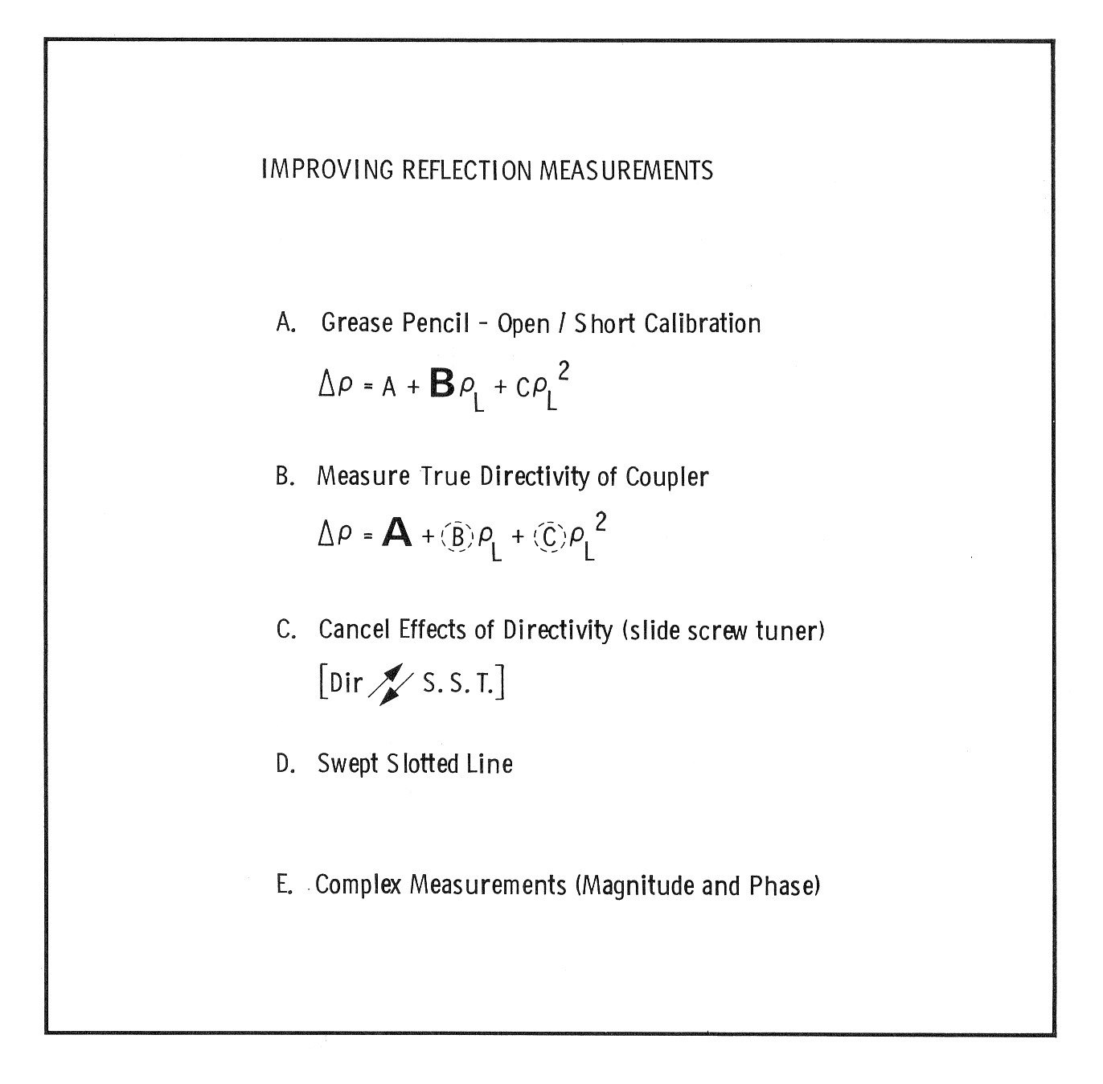

Slide 56
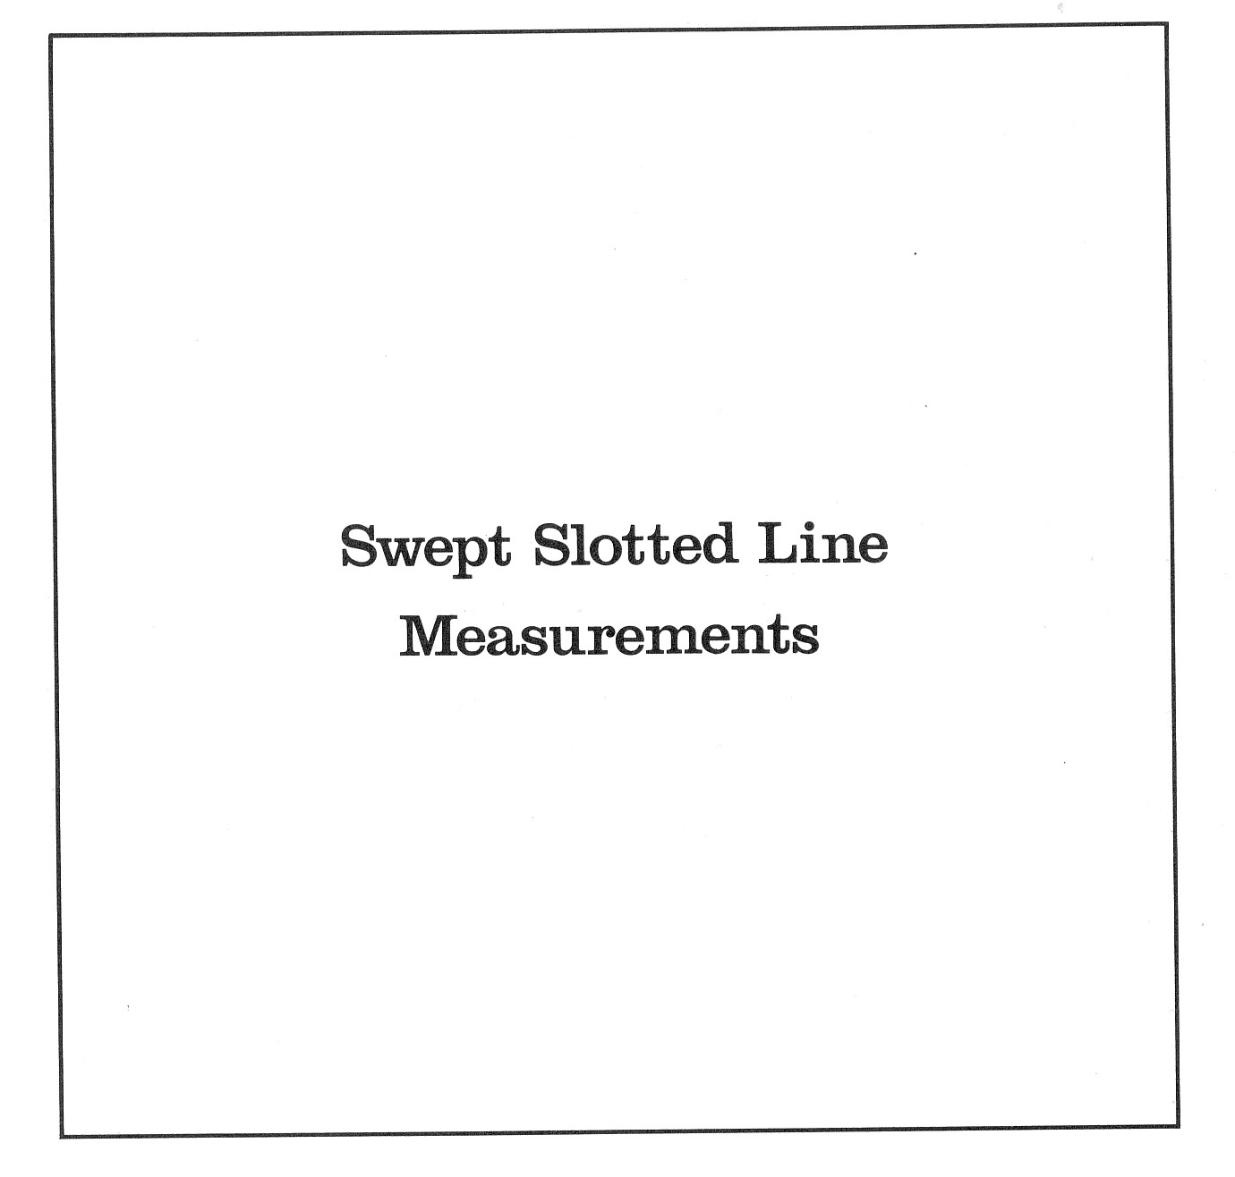

Slide 57
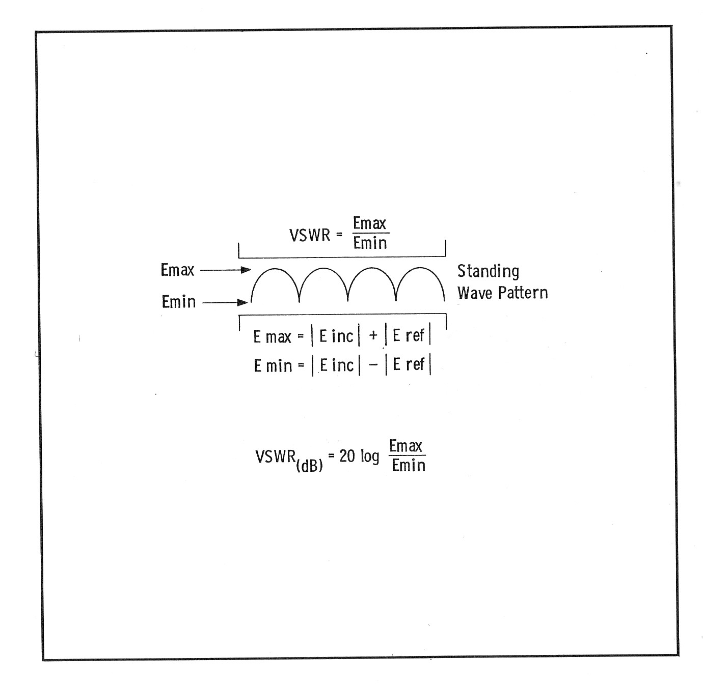

Slide 58
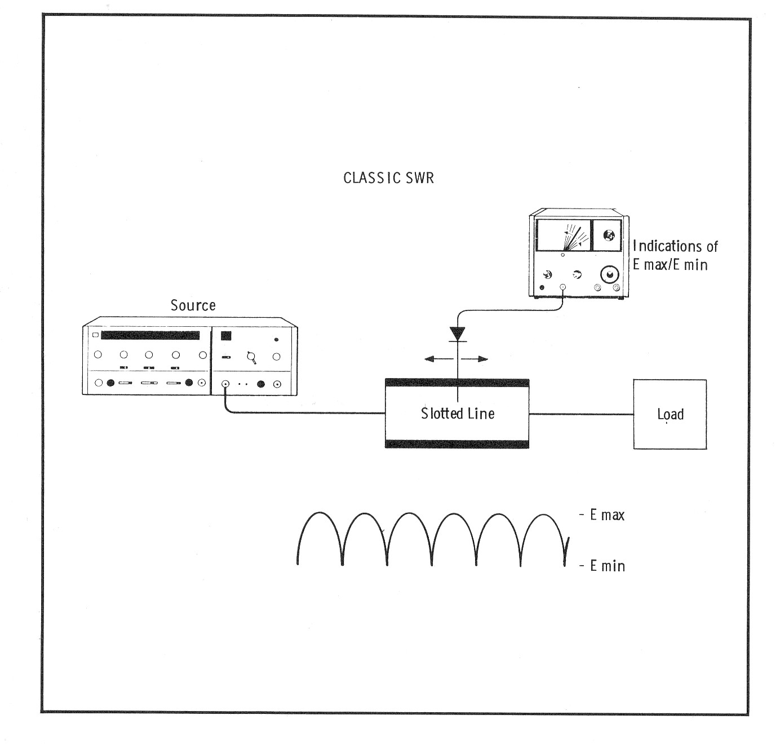

Slide 59
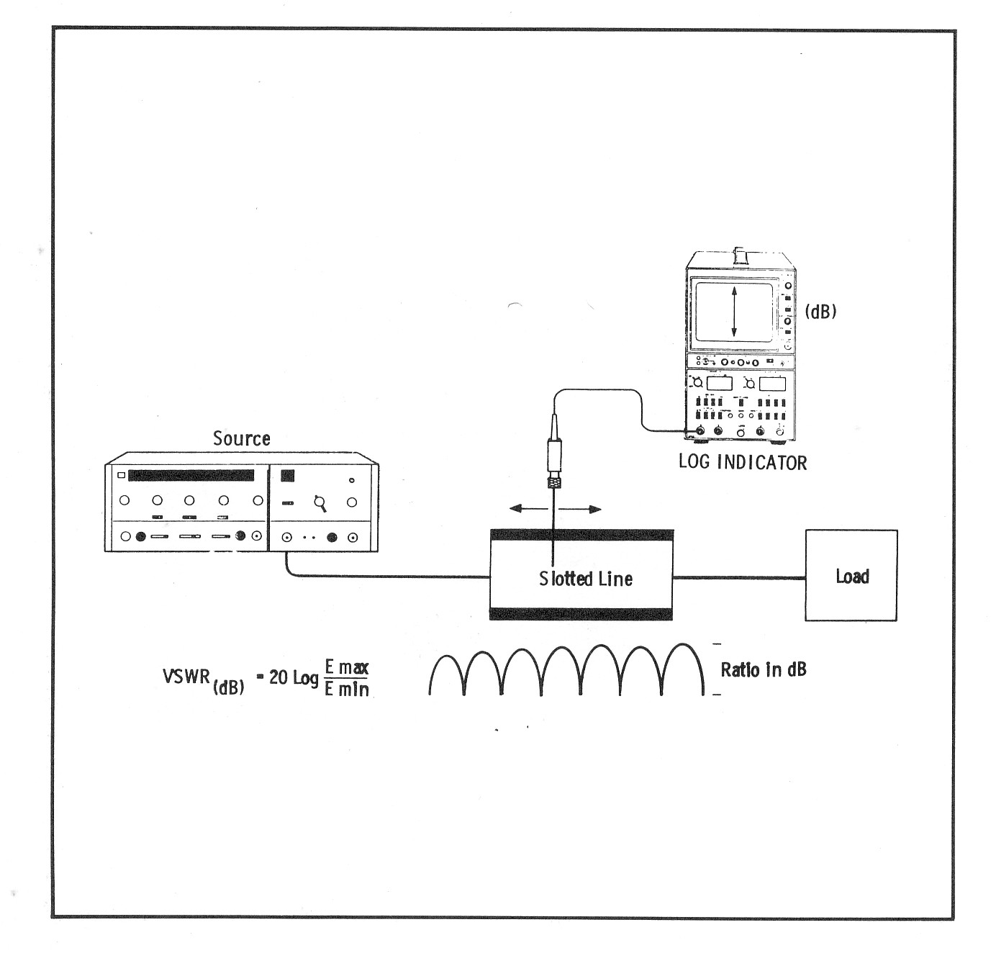

Slide 60

Demo Pengukuran dgn Slotted Line

Slide 61


Slide 62


Slide 63


Slide 64


Slide 65


Slide 66


Slide 67


Slide 68


Slide 69


Slide 70


Slide 71


Slide 72


Slide 73


Slide 74


Slide 75


Slide 76


Slide 77


Slide 78


Slide 79


Slide 80


Slide 81


Slide 82


Slide 83


Slide 84


Slide 85
THE END

